Slide 1


Emotional Intelligence
Building Your Skills As a Leader: Emotional Intelligence 101
Heidi Carl, Assistant Vice Provost and Executive Director, Purdue University
NASFAA National Chair

Slide 2

ISFAA 2026 Conference
What is Emotional Intelligence?
Emotional awareness, including the ability to identify your own emotions and those of others;
The ability to harness emotions and apply them to tasks like thinking, behavior and problem-solving;
The ability to manage emotions, including the ability to regulate your own emotions, and the ability to cheer up or calm down another person.
The ability to discriminate between different feelings and label them appropriately.

Slide 3

Emotional Intelligence begins with Self Awareness
ISFAA 2026 Conference
Eight categories of emotions
Anger
Fear
Love
Disgust
Shame
Sadness
Enjoyment
Surprise
What emotions can you think of and what category do they go with?

Slide 4
After Self Awareness comes
Self Management or Self-regulation
ISFAA 2026 Conference
I have this emotion now what do I do with it?
Emotional self control
Adaptability
Achievement orientation
Positive outlook
Striving toward goals for personal reasons, not a reward
Take time for mistake autopsy—this isn’t about blame but about thinking through what happened.

Slide 5
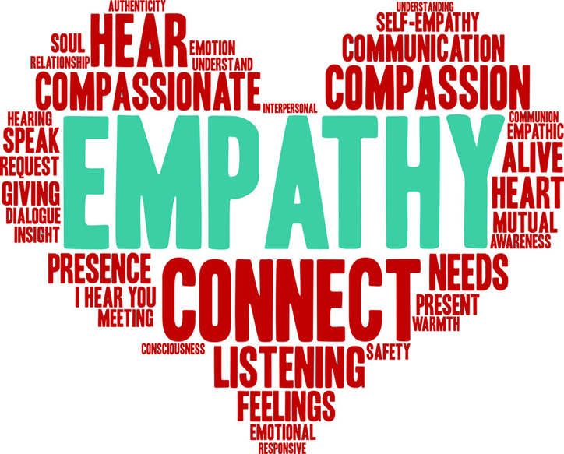
Having Social Awareness
ISFAA 2026 Conference
Empathy
Feeling with someone
Organizational Awareness
Try to understand more about other areas of your organization
Build networks

Slide 6

How do you practice and show empathy?
ISFAA 2026 Conference
Dr. Brene’ Brown’s four step approach
Perspective taking, or putting yourself in someone else’s shoes
Staying out of judgement and listening
Recognizing emotion in another person that you have maybe felt before
Communicating that you can recognize that emotion.

Slide 7

Relationship Management is Key
ISFAA 2026 Conference
Influence
Conflict Management
Inspirational Leadership
Coaching and Mentoring—Find one and be one
Teamwork—Trust drives teams
Ask yourself…would you want to work for you?

Slide 8

Why is Emotional Intelligence Important?
ISFAA 2026 Conference
Studies have shown that people with high Emotional Intelligence have greater mental health, job performance and leadership skills.

Slide 9
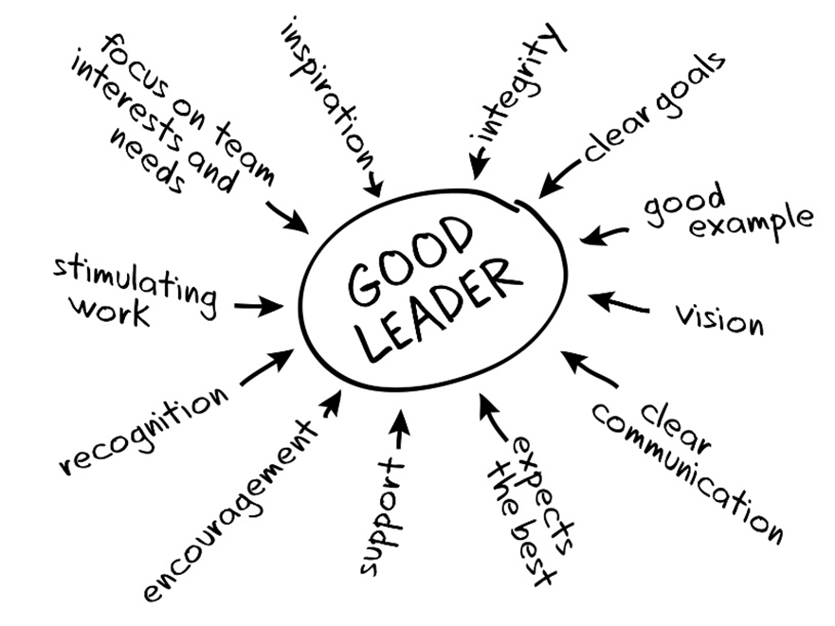
Being a Leader with
Emotional Intelligence
ISFAA 2026 Conference
Leaders with EI are able to motive others to act
Leaders with EI are able to model the way for others
Leaders with EI are able to encourage their heart and the hearts of others to reach their team goals

Slide 10
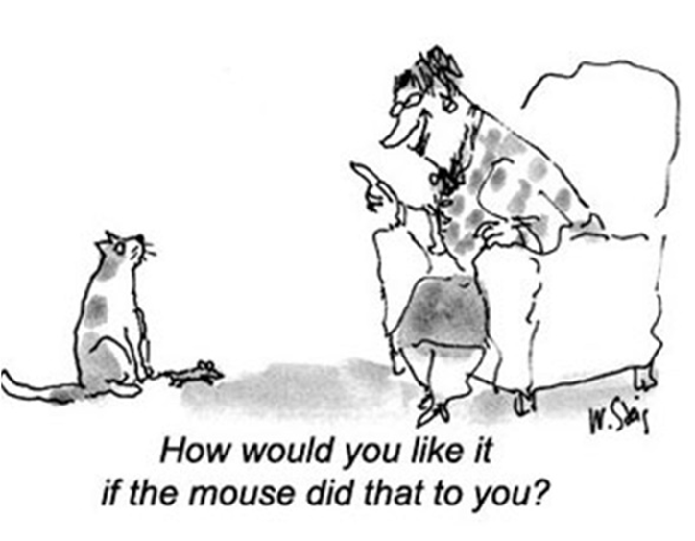
Being a Leader with
Emotional Intelligence
ISFAA 2026 Conference
How do they do this?
By having integrity and acting as a role model in both actions and words
By having confidence in the abilities of individuals and enabling them to achieve to their potential
By being empathetic to the needs and personalities of individuals and tailoring recognition and feedback to meet these needs and temperament

Slide 11
What does an EI leader look like?
ISFAA 2026 Conference
From Korn Ferry study:
They listen more than they talk
They emphasize the how and why, instead of simply telling people what to do
They engage team members and recognize their contributions, rather than continually criticizing and correcting their mistakes
They resolve disagreements openly and deal with people’s emotions during conflict
They understand what energizes and engages people on their teams-and create environments that foster that energy
They encourage team members to stay five years or more in the organization, because they feel engaged and able to do their job effectively.

Slide 12
EI Assessment
ISFAA 2026 Conference
Take the Emotional Intelligence Assessment
to learn more about where you are
on your EI journey?
What did you learn?

Slide 13

Final Thoughts?
ISFAA 2026 Conference
Any questions? Thoughts?
carlh@purdue.edu

Slide 14
Thank you!

