Slide 1
Practical Strategies to Serve Under-Resourced Students
Marvin Smith
Executive Director of Student Financial Services, IUPUI

Slide 2
Indiana University-Purdue University Indianapolis
(IUPUI)
Large Urban Public Research University with a student population of about 30,000 students offering 350 degree programs from both Indiana University & Purdue University
An Indiana University core campus located in downtown Indianapolis, the 15th largest US city and a Super Bowl host
Seventeen degree-granting schools (2 from Purdue); largest Med School in US, Law, Dentistry, Nursing, Public Health, Engineering & Technology, Science, Business, Art, Social Work, Philanthropy, etc.
Recognized for Learning Communities & the First Year Experience programs that help ensure a positive collegiate experience for new freshman and undergraduates (U.S. News)
First-Time cohort about 3,700 and New External Transfers of about 1,200 each year
Approximately 40% undergraduates are Federal Pell Recipients and 35% are First Generation

Slide 3
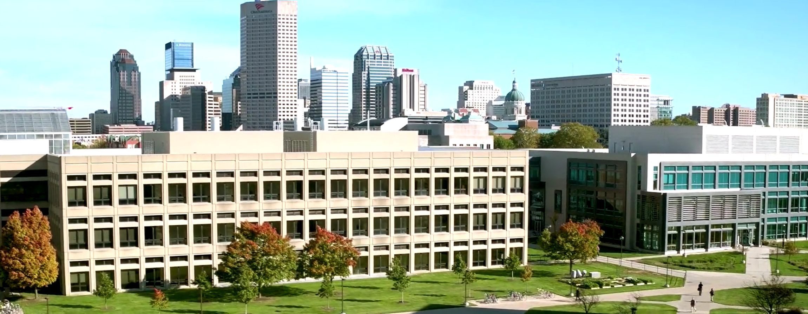

Slide 4
IUPUI and Lumina Partner on Beyond Financial Aid (BFA) Initiatives
Builds on three guiding principles…
A large and growing number of postsecondary students face the challenges created by limited resources. In fact, approximately one in three American undergraduates receives a Pell grant and is therefore considered a low income student.
When institutions structure and offer all types of financial aid (including nontraditional supports) in a coherent, consumable way, students will persist longer, generate additional revenue for the institution, and graduate at higher rates.
Providing these supports in an intentional way is NOT an impossible dream. Colleges across the country are already doing it and doing it well.
www.luminafoundation.org/beyond-financial-aid
Notes:
Marvin

Slide 5
Beyond Financial Aid Challenge
How do we do more with less AND facilitate student success?
How can we provide students more affordable housing, food, transportation, healthcare, childcare, legal services, and academic support services?
How can community partners help?
How can we connect needy students with available resources?

Slide 6
Five Strategies To Increase Support Of Low-Income Students
Strategy 1: Know your low-income students. Each institution varies in the specific makeup of its low-income students and in the supports it offers those students. Reviewing quantitative and qualitative institutional data can help determine accurate numbers and characteristics of low-income students, how they experience the institution, and which factors affect their ability to succeed.
Strategy 2: Review internal processes and organize supports. Institutional policies and practices are created to achieve specific outcomes and to address specific conditions. As time passes, however, what was designed to be a resource and/or reasonable process may become ineffective or have unintended negative consequences (academic, financial, or otherwise) on low-income students. While there may be an array of resources and supports for students, institutions can help low-income students overcome practical barriers to completion by reviewing internal processes and organizing supports to better meet their needs.
Strategy 3: Build internal and external partnerships. Institutions can leverage and expand their capacity to meet the needs of low-income students by building partnerships to include internal groups—faculty, administrators, staff, students, and alumni; and external organizations with shared missions and commitments. Strengthening these partnerships can benefit students, institutions, and the external organizations.
Strategy 4: Optimize students’ use of services. While some students proactively seek out services and resources, many others do not. Improving the accessibility of financial supports by reducing hassle factors, simplifying students’ choice-making, and providing clear messages and reminders to students about financial support services can increase their use.
Strategy 5: Create a culture of support. Many institutions are exploring practices known to encourage the progression and achievement of all students. However, without sustainable, integrated institutional strategies that stabilize their finances and shore up their academic experiences, low-income students are at particularly high risk of not reaching their goals for postsecondary
Notes:
Marvin

Slide 7
Five Strategies To Increase Support Of Low-Income Students
Strategy 1: Know your low-income students.
Each institution varies in the specific makeup of its low-income students and in the supports it offers those students. Reviewing quantitative and qualitative institutional data can help determine accurate numbers and characteristics of low-income students, how they experience the institution, and which factors affect their ability to succeed.
Notes:
Marvin

Slide 8
National Research Context
“Even when students manage to cobble together scholarships, loans or gifts from relatives or churches, once they actually get into college, they typically find they have a whole new set of unanticipated barriers: academic, social and cultural, as well as their own internal self-doubt.”
Cardoza, k. (2016). First-generation college students are not succeeding in college, and money isn’t the problem. Social and cultural factors are working against many students who are the first in their family to pursue higher education. Washington Post

Slide 9
Defining the Financial Challenge
The National Common Data Set provides a framework for calculating a student’s academic year financial need that is “met” by different sources of financial support. Unmet Need is the portion of a student’s academic year financial need that exceeds these forms of financial support.
Calculation Example
Cost of Attendance (COA)
Tuition/fees, housing/meals, books/supplies, travel, and personal expenses = $24,000
Expected Family Contribution (EFC)
A FAFSA-driven expectation of family financial support - $10,000
Gift Aid
Scholarships, grants, etc. from federal, state, IUPUI, and private sources - $1,000
Self-Help Aid
Subsidized federal loans and federal work study earnings - $8,000
Difference is Unmet Need = $5,000*
* Students must take out unsubsidized loans, private loans, or work to support unmet need
Notes:
Michele

Slide 10
IUPUI Annual Unmet Financial Need and One-Year Retention FT, FT Beginners
Notes:
MJH

Slide 11
Unmet Financial Need Academic Year Fall 2016 IUPUI Indianapolis | N | % of All
No FAFSA on file | 4092 | 21%
No Unmet Financial Need (FAFSA on file) | 5120 | 26%
$1 to $1000 Unmet Need | 827 | 4%
$1001 to $2000 Unmet Need | 760 | 4%
$2001 to $3000 Unmet Need | 711 | 4%
$3001 to $4000 Unmet Need | 615 | 3%
$4001 to $5000 Unmet Need | 744 | 4%
$5001 to $6000 Unmet Need | 802 | 4%
$6001 to $7000 Unmet Need | 880 | 4%
$7001 to $8000 Unmet Need | 701 | 4%
$8001 to $9000 Unmet Need | 623 | 3%
$9001 to $10,000 Unmet Need | 511 | 3%
More Than $10,000 Unmet Need | 3196 | 16%
Grand Total | 19582 | 100%
* 5911 students with unmet need > $6K

Slide 12
IUPUI Pell Grant Recipients (SES indicator)

Slide 13
IUPUI Pell Grant Recipients (SES indicator)
Notes:
MJH

Slide 14
IUPUI Students Who Received a Federal Pell Grant
Less likely to graduate with High School Academic Honors Diploma.
More likely to register for courses late.
Less likely to earn AP credit.
More likely to test into developmental math.
Less likely to enroll in 15 credit hours.
More likely to be first-generation.
More likely to be in an underrepresented group (African American, Latino/a, Two or More Races), noting 81% African American and 68% Latina/o beginners received a Pell Grant.
More external commitments (working off-campus, care for dependents, commuting, taking care of household responsibilities).
Less likely to live in campus housing.
More likely to rate themselves below average or having low levels of emotional and physical health.
More likely to expect to experience stress in balancing school with family demands.
More likely to have major or some concerns about ability to finance college education.
Less confidence in academic ability, math skills, and writing skills.
Lower rates of academic performance at IUPUI (GPAs).
Source: IUPUI Institutional Research and Decision Support

Slide 15
IUPUI Average Net Price by Income Grids: Trending Down

Slide 16
Five Strategies To Increase Support Of Low-Income Students
Strategy 2: Review internal processes and organize supports.
Institutional policies and practices are created to achieve specific outcomes and to address specific conditions. As time passes, however, what was designed to be a resource and/or reasonable process may become ineffective or have unintended negative consequences (academic, financial, or otherwise) on low-income students. While there may be an array of resources and supports for students, institutions can help low-income students overcome practical barriers to completion by reviewing internal processes and organizing supports to better meet their needs.
Notes:
Marvin

Slide 17
IUPUI Business Process Enhancements
Students with demonstrated level of financial need can provide a Financial Aid Need Summary to the Student Health Center to have their provider visit charge reduced to $25.
Developed way for low income students to accept institutional grants AND accept admissions deposit waiver
Encourage earlier orientation sign up for low income Pledge Grant recipients as a “requirement” of grant to ensure students get into Bridge and assigned to support programming

Slide 18
Five Strategies To Increase Support Of Low-Income Students
Strategy 3: Build internal and external partnerships.
Institutions can leverage and expand their capacity to meet the needs of low-income students by building partnerships to include internal groups—faculty, administrators, staff, students, and alumni; and external organizations with shared missions and commitments. Strengthening these partnerships can benefit students, institutions, and the external organizations.
Notes:
Marvin

Slide 19
Partnerships and Activities
School of Social Work partnership
Social Work getting student interns into Student Financial Services, 21st Century Scholar Support Programs, desire for other areas down the road
Social Work class assisted in https://helpmeROAR.iupui.edu website development
Office of Student Advocacy and Support enhancements (focus on food, housing, clothing insecurity)
Campus-wide Beyond Financial Aid committee
Awareness presentations for faculty and staff
Newer focus on Faculty/Staff/External Partners training and website: http://assist.iupui.edu
City of Indianapolis partnership
Other community partnerships (We need to do more!)

Slide 21
HelpMeRoar.iupui.edu

Slide 24
‘Indy Achieves’ Partners with IUPUI and Ivy Tech
Marion County residents attending Ivy Tech and IUPUI qualify for additional financial assistance and wrap-around services
Indianapolis City-County Council appropriates $2 million for program

Slide 25
Five Strategies To Increase Support Of Low-Income Students
Strategy 4: Optimize students’ use of services.
While some students proactively seek out services and resources, many others do not. Improving the accessibility of financial supports by reducing hassle factors, simplifying students’ choice-making, and providing clear messages and reminders to students about financial support services can increase their use.
Notes:
Marvin

Slide 26
Make Information More Accessible
Help Me R.O.A.R website
Emergency grant website
Decentralized financial support services
Going into classrooms
Encouraging decentralized advocacy support

Slide 27
IUPUI Financial Services Delivery Coordination
IUPUI Pledge Grant expectations
Jaguar Persistence Grants/Scholarships
Emergency Grant Programs in Student Financial Services and in schools
Expanded approach to emergency financial aid programs to more widely advertise and normalize the fact that IUPUI student face various financial challenges
Even if a student does not qualify for a particular program, we have found the counseling we can provide is effective in helping the student weigh and explore different aid options
Advice on fitting emergency aid into financial aid packages

Slide 28
Five Strategies To Increase Support Of Low-Income Students
Strategy 5: Create a culture of support.
Many institutions are exploring practices known to encourage the progression and achievement of all students. However, without sustainable, integrated institutional strategies that stabilize their finances and shore up their academic experiences, low-income students are at particularly high risk of not reaching their goals for postsecondary education
Notes:
Marvin

Slide 29
Faculty Advice: “Show Them They Belong”
Non-traditional students should have alternative options regarding traditional orientations and services
Faculty should reach out to those students who are tardy and missing – personally connect, ask what is going on
Normalize outreach for additional basic needs benefits
Understand that there is a “hidden language” that prevents many first generation students from feeling like they fit in or belong (leading to “impostor syndrome”)

Slide 30
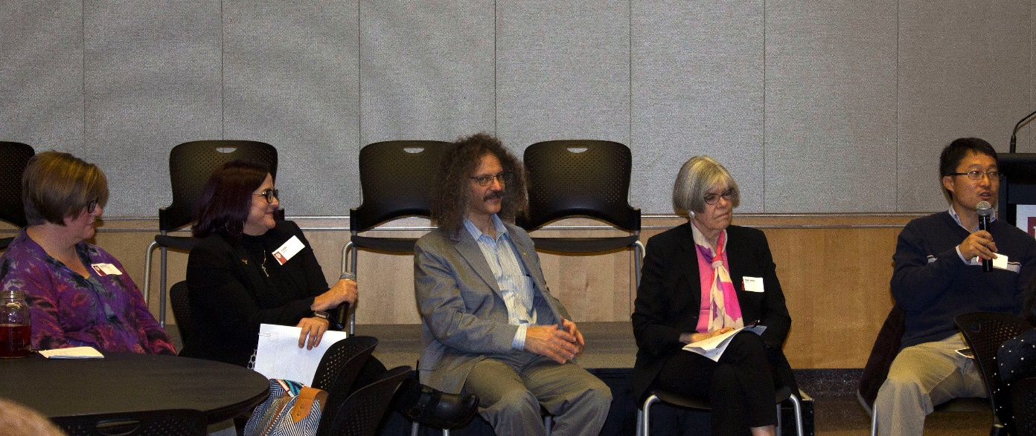
Faculty Advice: “Personal Stories Can Create Bonds”
Create a narrative that allows your students to see you as someone they can relate to and connect with.
Provide nontraditional contact options as typical office hours are often inaccessible to nontraditional students due to tight class schedules
Coach students as opposed to “telling” them
Do more listening and less speaking

Slide 31
IUPUI Faculty Quote “The more I partner with students and erase and breakdown hierarchies and treat them partner to partner, human to human, the more responsive the whole class becomes – it is like an emotional virus—it just takes a couple of students and the rest of the class joins in”

Slide 32
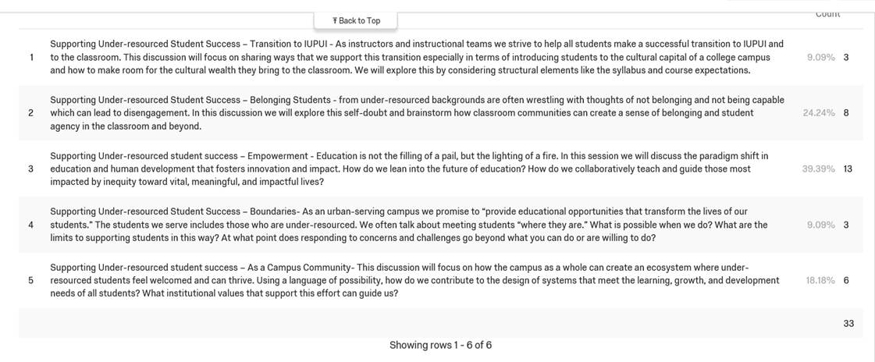
Topics at next Beyond Financial Aid faculty seminar

Slide 33
IUPUI Student Experience Council Financial Strategies Taskforce Recommendations

Slide 34
Regarding Cost Issues…
1. Tuition and Fees: Offer more flexible payment plan options and evaluate the assessment of extra fees that may unfairly penalize under resourced students
2. Housing and Meals: Explore more affordable campus housing strategies and consider ways to make campus food plans more affordable and tiered
3. Books and Supplies: Promote ways to lower the costs of textbooks through Open Education Resources (OER)
4. Transportation: Consider whether the costs of student parking could be reduced or tiered and take a new look at public transportation infrastructure

Slide 35
Regarding Resource Issues…
5. Devote more resources to need-based scholarships and grants
6. Devote more resources for emergency situations (food, shelter, basic needs)
7. Consider ways to offer students higher pay for on-campus jobs

Slide 36
Regarding Financial Education…
8. Develop more intrusive, early, and ongoing financial education planning and communication
9. Improve financial education efforts before enrollment, noting that low income nonresident students are a special time consuming concern
10. Expand the services of the student advocate’s office to connect needy students with available IUPUI and community resources

Slide 37
Feedback? Questions? What is Working at Your Institution? Contact info: Marvin Smith, mlsiii@iupui.edu

