Slide 1
You Win Some, You Lose Some: When Prizes and Awards
Make People Sad
Jenny Stephens
University Director of Financial Aid
Indiana University
ISFAA Winter Conference, January 2019

Slide 2
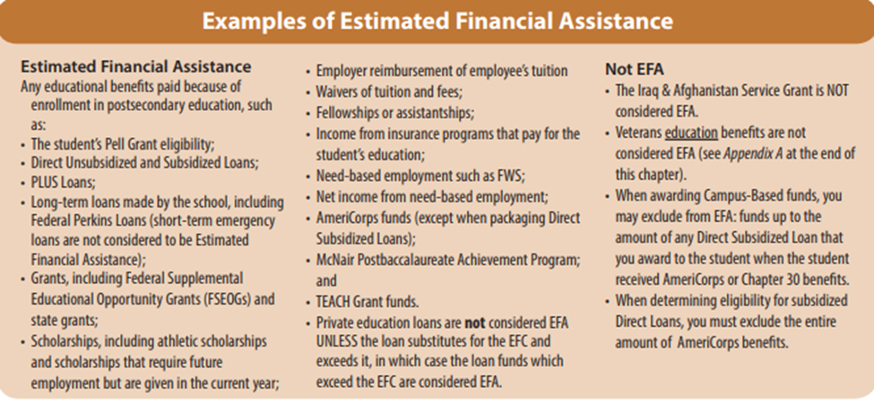
What is Estimated Financial Assistance (EFA)?

Slide 3
Estimated Financial Assistance
Any educational benefits paid because of enrollment in postsecondary education, such as…
And from NASFAA’s AskRegs:
…including but not limited to- ... (iii) Any educational benefits paid because of enrollment in a postsecondary education institution, or to cover postsecondary education expenses;..." The assumption for this part of the definition is that the student would not be receiving the assistance if he or she was not enrolled at a postsecondary institution. [685.102(b)]

Slide 4
If it is EFA, it has the potential to impact aid recipients in a manner not intended
People who have institutional funds for students don’t want any other money taken away
There are strings attached when you have federal aid

Slide 5
Ronald E. McNair Postbaccalaureate Achievement Program – TRIO
Added to EFA “table” in 2011-12
Through a grant competition, funds are awarded to institutions of higher education to prepare eligible participants for doctoral studies through involvement in research and other scholarly activities.
Participants are from disadvantaged backgrounds and have demonstrated strong academic potential. Institutions work closely with participants as they complete their undergraduate requirements.
Institutions encourage participants to enroll in graduate programs and then track their progress through to the successful completion of advanced degrees. The goal is to increase the attainment of Ph.D. degrees by students from underrepresented segments of society.

Slide 6
Indiana University’s Journey to a Policy
WHY?
Volume of funds going to students
Variety of payment methods
Recognition of disparate practices
Concern about institutional risk
Conflicting internal/external guidance

Slide 7
WHO?
~23 people across the university, representing:
Financial Aid
Tax
HR
Bursar
Payroll
Travel
Finance
Purchasing
Academic Affairs
Administrative Services
Enrollment Management
International Programs
IU Foundation
the Graduate School
Research
Legal Counsel

Slide 8
HOW?
Very painfully, over the course of more than three years
Subcommittees:
Definition of Scholarship, Fellowship, Fee Remission
International and Travel
Awards and Prizes
Other Special Topics Added:
Research Experiences for Undergraduates (NSF)
Is it work?

Slide 9
What we found
Every stakeholder is looking at different rules and even words, through their lens
Many rules conflict with other rules
Every stakeholder can find another institution that adopted ‘their view’
Policies run the gamut from liberal to conservative
There are no 100% right answers – live with gray

Slide 10
What we did
Dissected our reality
Looked at rules all stakeholder’s brought to the table
Worked in subcommittees, presented to the whole
Argued, respectfully
Created a document

Slide 11
What we did (continued)
Edited and pared it down, over and over
Reorganized it
Created one super flowchart!
Tested it in a limited release
Took it on the road!

Slide 12
Back to Prizes and Awards…
IU previously defined a prize as something you win in a drawing, contest or game of chance.
We determined that it is EFA if:
The activity is restricted to students, or
The contest is related to the student’s courses or degree completion, and
The prize is cash, a cash equivalent (gift card) or a non-cash item that can be used for educational purposes or to pay for expenses included in the student's cost of attendance.

Slide 13
Awards
There are more “Graduation Awards” than we realized – timing doesn’t matter!
IU has determined these and other awards for students are always EFA
NASFAA’s AskRegs has an entry about this worth review

Slide 14
What does IU do to keep the peace?
Educate the community – continuous challenge
Encourage reconsideration of graduation awards, where possible
Spread the word so that departments making these awards can add disclaimers when promoting them
Look for legit budget increases
Send back loan funds

Slide 15
What does all this mean?
Your policies don’t have to look like IU policies
It’s pretty gray
Remember, you can find examples all across the spectrum of liberal to conservative
However, your institution should endeavor to:
Have policies
Document a well-reasoned justification
Make the policies known to those with the money
Apply them consistently

Slide 16
Getting Started
Identify stakeholder offices and people to represent them
Articulate the risk and define the urgency based on where you are, now
Find an executive-level champion
Start the conversations

Slide 17
If there’s time… Scholarship or Compensation?
If it looks like work and smells like work, it’s probably work and should be paid and taxed as such (FLSA, ACA)
It’s an inadvisable short-cut to allow a unit to provide scholarships for work.
Tests IU has articulated:
Is the university the primary beneficiary of the services?
Would another student or person be chosen to complete the services if the first student was unable to perform or complete the task?
Are students who receive this award required to perform the services on a quid pro quo (contingent) basis?
If any answer is “yes” IU says it is work.

Slide 18
Resources, References:
EFA slide 1 – FSA Handbook
https://ifap.ed.gov/fsahandbook/attachments/1819V3C7FinalDec.pdf pg 3-145
NASFAA’s AskRegs – Treatment of EFA
https://nasfaa.microsoftcrmportals.com/knowledgebase/qa/KA-33455
NASFAA’s AskRegs – Graduation Prizes
https://askregs.nasfaa.org/knowledgebase/qa/KA-33595/en-us
IRS – Publication 970 Tax Benefits for Education
https://www.irs.gov/pub/irs-pdf/p970.pdf
IU Bloomington Student Payment Guidelines
https://sos.osfa.indiana.edu/content/index.shtml

Slide 19

Jenny Stephens
University Director of Financial Aid
University Student Services and Systems
400 E 7th St, Poplars 605
Bloomington, IN 47405
812-855-1053
stephejl@indiana.edu

