Slide 1
Understanding Organizational Environment
(How to save your head in the real world)

Slide 2
Organizational Environment
Goals for this session:
Define Organizational Environment
Breakdown of Organizational Environment
Task v. General
Internal v. External
Examples of understanding and not understanding
Applying Organizational Environment Theory in the FAO

Slide 3
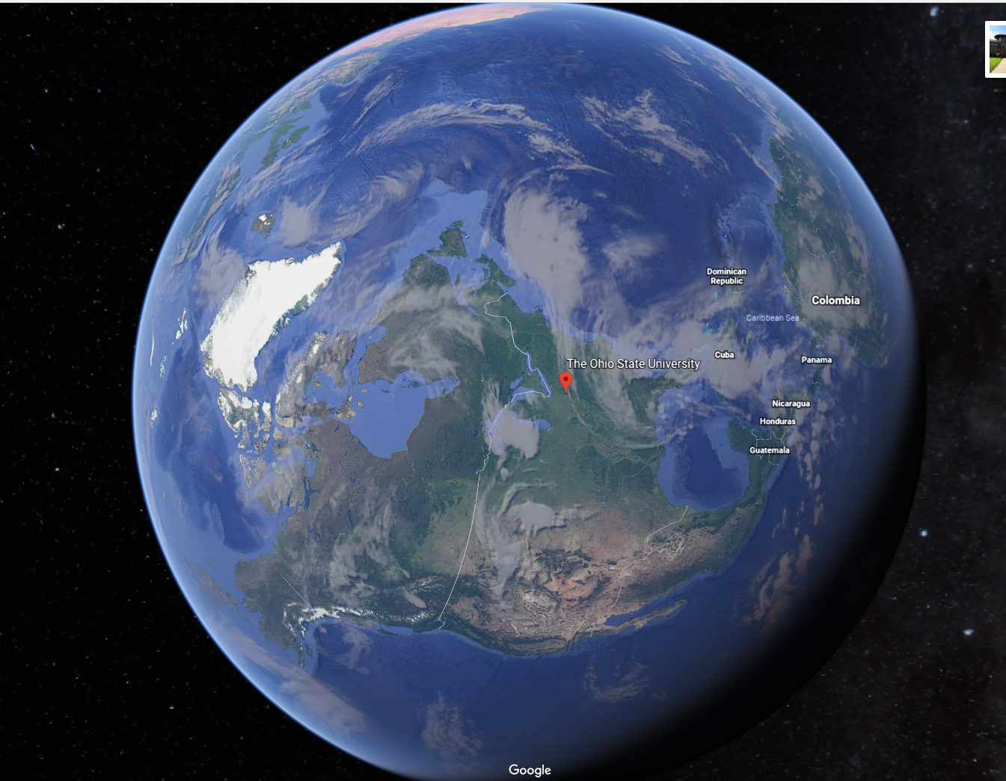
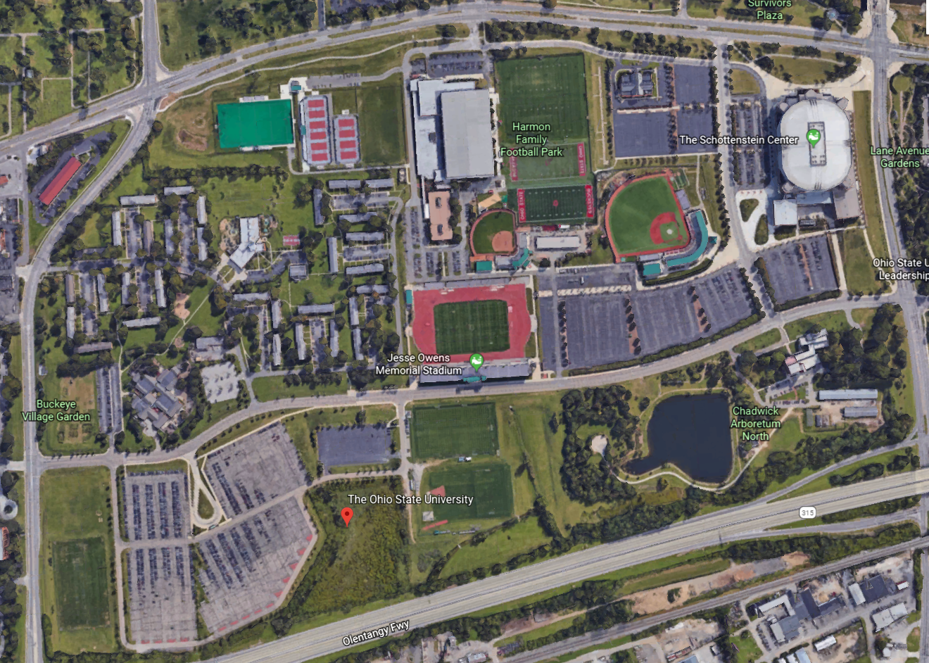
THIS or this?

Slide 4
It’s All About PERSPECTIVE
This is Jim.
Jim KNOWS financial aid verification.
REALLY WELL
People keep bringing him more and MORE
Jim won’t smell the wind of change or see the tidal wave coming at his office.

Slide 5
Definitions - Organizational Environment:
are composed of:
forces or institutions surrounding an organization that affect performance, operations, and resources
includes all of the elements that exist outside of the organization’s boundaries
have the potential to affect a portion or all of the organization
all the elements existing outside the boundary of the organization that have the potential to affect all or part of the organization

Slide 6
The Environment of the Organization
General Environment
Students / Parents
Other Schools
Donors
Accreditors
State Agencies
ED
Federal Politics
State Politics
Economy
Technology
Social
Task Environment
Internal Environment
Admin
Employees
Management
Culture of School

Slide 7
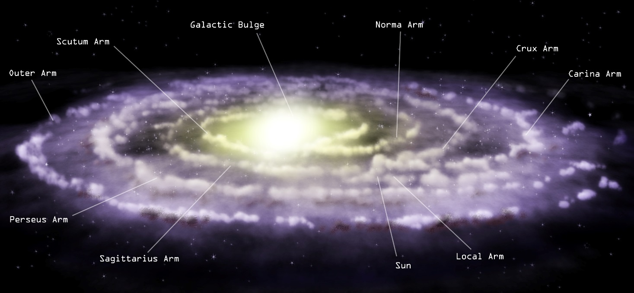
General Environment
World Trends
Politics (Federal, State and Local)
Environmental
Economy
Chaos
Technology
Social Atmosphere
Demographic Shift
Cultural Change

Slide 8
Well, maybe that is a little too big
but things on a global scale affect our everyday life and the environment of schools and our financial aid offices.
So what are some examples of global environmental pressures?

Slide 9
Modern World Events Affecting Higher Ed
Global Warming
Bubble Burst of 2008
Continued growth of Distance Ed
Population Growth

Slide 10
Modern National Events Affecting Higher Ed
Election of Bush ’43
Healthcare
Striking of DOMA
Browning of America
Greying of America
Experiential Based Credit

Slide 11
Technology
Areas the internet has changes us on the educational level:
Recruiting
Selection
Counseling
Notification
Billing
Teaching
Interaction
Grading
Dating

Slide 12
Let’s look at Ned
Born Leader
Loyal to a fault
Honest / Truthful
Understands his responsibility to his people
Ned takes a new position at his best friend’s request. What happens?

Slide 13
How could Ned have faired better?
Learned the ways of his new city
Allowed himself to be malleable
Led a rebellion
Quit and move home

Slide 14
Let’s look at Danny
Born Leader
Willing to make tough decisions
Recognizes the needs of her peoples
Knows how to give her people what they want so they will love and follow her
Willing to admit when she doesn’t know
Relies on her advisors but will defy them when she believes they are wrong.

Slide 15
Adaptation to Environmental Change
Willingness to change.
Observes the realities and adapts to her people’s needs
As she is conquering, she gives to the people different things based upon the culture that they accustomed to living

Slide 16
Let’s Consider: Jon
Promoted by election
Good leader
Willing to do what is right
Fails to take into account animosity created by his decisions
Leaves as his lieutenants those who stand against him.
If I go any further, there will be spoilers so we’ll stop here.

Slide 17
Task Environment
Any entity with direct involvement with your school is part of your task environment

Slide 18
Students

Slide 19
Parents
Hovers (AKA Helicopter Parents)
Alumni Parent
Million Question Dad
Hardcore Parent
Cool Mom
Almost Empty Nesters
- Your Teen - Jane Parent

Slide 20
Partners
Our Friends at the US Department of Education (ED)
Interpreter
Guidance / Trainer
Grantor
Lender
Enforcer

Slide 21
Partners
CHE
Vocational Rehabilitation
Veterans Affairs
Community Foundations
ISFAA
IACAC
High School Counselors

Slide 22
Other Universities
Competitors or Compadres

Slide 23
Competitors
If you build it, they will come
HERE

Slide 24
Compadres

Slide 25
The Internal Environment
Mission Statement
Structure (Organizational Chart)
Organizational Culture
Tone
Resources
Philosophy of Management
Employees
Culture of the school

Slide 26
Let Take this down A Notch
Lets consider the FAO as the organization and the environment then becomes everything we have already talked about plus the college or university itself.

Slide 27
Org Chart for Wichita State
Now we have a whole new game in play

Slide 29
Members of the Financial Aid Office Environment
Higher Ups
aka General Environment
President
Provost
Vice Provost
Assistant Vice Provost
Partners
aka Task Environment
Admissions
Bursar
Bookstore
Student Employment
Student Success
Housing
Lenders
Students

Slide 30
For you to become successful YOU need to learn the internal and external environments or your organization
You must do this on the school and the financial aid office levels.
Can you go deeper?

