Slide 1
Understanding the EFC
Jenny Stephens
University Director of Financial Aid
Indiana University
ISFAA Winter Conference, January 2019

Slide 2
A brief look back…
1986 – a pivotal point
CSS FAF, fee-based with waivers
Student Aid Index (Pell)
GSL Needs Test
Carbon Paper!
New - Congressional Methodology

Slide 3
Congressional Methodology Features
Three Formulas
Simplified Need Test
Minimum Student Contribution
Independent Status “Loophole”
Home Equity in Assets
Common Financial Aid Form for all federal aid, no-fee option
Maintained Separate Formula for Pell

Slide 4
1992 – Federal Methodology (Uniform)
Merged 2 formulas into one
The Birth of the FAFSA as we know it (but paper)
Auto Zero EFC
Elimination of Minimum SC
Elimination of Home Equity and “Family Farm” from Assets
Strict Rules for Independent Status

Slide 5
Relative Stability…
EFC Formula Guide 2019-20
What is the EFC?
Then and Now
There’s been a “shift”

Slide 6
Three Basic Formulas
X 2: Standard and Simplified
+ Auto Zero EFC

Slide 7
“Simplified” Test – Who Qualifies?
Two Components – Income plus any
1 of 3 other qualifiers
AGI (or work income) of $49,999 or less
AND,
Means-Tested Federal Benefit, OR
Not required to file 1040 long form, OR
Dislocated Worker (very few!)

Slide 8
Auto Zero EFC
Simplified with Lower AGI - $26,000
Big Changes!

Slide 9
Dependent Student Walk-Through
The Worksheet is broken into blocks
Income (check for Auto Zero)
Allowances
Assets (Skip for Simplified)

Slide 12
Indiana is 4% and 3% Social Security Allowance for Each Work Income

Slide 13
Family of 4, 1 student = $28,580

Slide 14
IPA Assumptions
Student COA: 9 mos of living expenses
Food – 30%
Housing – 22%
Transportation expenses – 9%
Clothing and personal care – 16%
Medical care – 11%
Other family consumption – 12%

Slide 15
Medical Expense Example:
Annual medical expenses are
11% of $28,590 = $3143
Includes Insurance premiums, deductibles, co-pays
Basis for Appeal?

Slide 16
Employment Allowance
Two Parents:
35% of the lesser of the work incomes
Max of $4000
One Parent:
35%, Max of $4000.

Slide 17
Assets
Straightforward
No home equity, no retirement accounts
Business / Investment Farm (Adjusted)
Add for “Net Worth”
Adjust for APA
Count 12% as PC from Assets

Slide 19
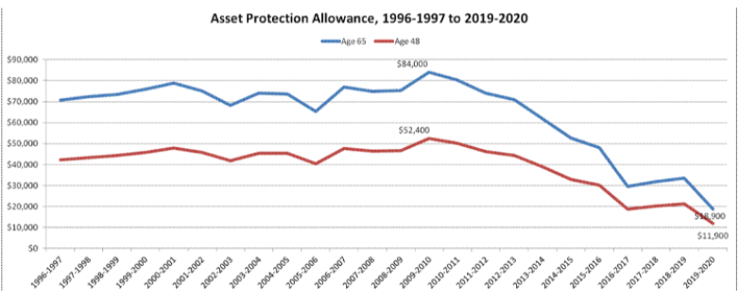
Big Changes Here!
“The FAFSA’s Asset Protection Allowance Continues to Crash”
- Mark Kantrowitz

Slide 20
APA: Two Parents, Oldest = 45
2011-12 $42,900
2014-15 $30,700
2017-18 $18,800
2019-20 $11,100

Slide 23
Student Contribution (Dep)
Income, pretty much the same
Allowances:
Federal tax, state and other (different table), social security withholding
Income Protection Allowance = $6660
Allowance for negative Parent AAI
Student Contribution from Income = 50% of
Total Income – Total Allowances

Slide 24
Assets, pretty much the same
Add for Net Worth – no reduction of
business / farm assets, no APA
Student Contribution from Assets = 20% of Net Worth
SC = “From Income” + “From Assets”
EFC = PC + SC

Slide 25
Independent, No Dependents Other than Spouse
Total Income looks just like Dependent Parent box
Allowances
Federal tax, state and other (different table), social security withholding
IPA = $10,360 if single, or spouse is a student
= $16,620, spouse is not a student
Employment Allowance only if married, both work
SC from Income: 50% of Income – Allowances

Slide 26
Assets, pretty much like parents
Add for Net Worth – Reduction of
business / farm assets like parents
APA like parents
Student Contribution from Assets = 20% of Net Worth
SC = “From Income” + “From Assets”
Half if spouse is married

Slide 27
Independent, With Dependents
Total Income looks just like Dependent Parent box
Allowances
Federal tax, state and other (different table), social security withholding
Employment Allowance like parent
Very Different Income Protection Allowance…

Slide 28
Family of 4, 1 student = $40,360

Slide 29
Assets just like parent, but only 7% of Discretionary Net Worth Becomes SC from Assets
Final Step, EFC just like parents
Available income + SC from Assets = Adjusted Available Income (AAI)
Total Contribution is AAI from the same table for parents
Divide by number in college

Slide 30
What Would You Change?

Slide 31
Resources:
EFC Formula Guide - https://ifap.ed.gov/efcformulaguide/attachments/1920EFCFormulaGuide.pdf
Lumina Foundation, “Form and Formula” - https://www.luminafoundation.org/files/resources/form-and-formula-viewing-guide.pdf
2002 Electronic Access Conference PPT on the evolution of financial aid
NASFAA Professional Judgment presentation at SASFAA - https://www.sasfaa.org/resources/Pictures/Conference2017/Presentations/Professional%20Judgment_Preconference%20%20SASFAA_Handout_013117_mj.pdf
APA Article: https://www.savingforcollege.com/article/the-fafsa-s-asset-protection-allowance-continues-to-crash
NASFAA 2013 recommendations - https://www.nasfaa.org/news-item/1672/NASFAA_s_Reauthorization_Task_Force_Recommends_Changes_To_Need_Analysis

Slide 32
Jenny Stephens
University Director of Financial Aid
University Student Services and Systems
400 E 7th St, Poplars 605
Bloomington, IN 47405
812-855-1053
stephejl@indiana.edu

