Slide 1
K-12 to College: Removing Barriers for College Success Tonya Monnier, Social Worker/McKinney Vento Liaison MSD Pike Twp. Karen Bush, Associate Director of K-12 - Indiana College Board

Slide 2
MSD Pike Twp. Profile
11, 209 enrollment
14 schools
9 elementary
3 middle
1 freshman center
1 high school
Preparatory Academy
81 languages
68 countries
93% graduation rate
A - School (IDOE rating)
Pike High School has approximately 3200 students

Slide 3
Pike High School Graduation Rate *Homeless Youth*
2019- 96%
2018-97%
2017-89%

Slide 4
If the changing landscape in the college readiness platform is difficult for students who have support, how do homeless students who do not have support and have food and housing insecurities maneuver through the process?
4

Slide 5
Polling Question
Do you feel knowledgeable about homelessness policies nationally and on your campus/ in your state?
Yes
No

Slide 6
What are the challenges students face??
1. Cost of education, funding/affordability
2. Deciding on a college/location
3. Standardized Testing
4. Social Skills and Maturity
5. Financial Aid/tax paperwork
Career/Major education
Food and Housing Issues
Mental health of students
Trust
10. Environmental Context/Grit

Slide 7
“Aha” moment
Calling a college for a student and being transferred 5 times….until I finally I hung up
Student returning to me stating the school wants the verification letter on their letterhead
Hearing student after student say…there is no way I can afford college or there is no way I can go to college
I don’t know enough about getting these kids to college…I need to visit the Graduation Coach- aka Karen Bush

Slide 8
Something needs to change…
A McKinney-Vento Liaison & a Graduation Coach team up
Realization that there are lots of barriers on homeless youth trying to go to college
Decided to start making a lot of noise about the problem.
Realized we had to do something BIG!!

Slide 9
What we did..…
Stood alongside students and said, “You are going to College!”
If we didn’t know…… we asked.
Built a team of key people
Developed Individual Student Plan on each homeless senior
Educate:
High School Counselors/College Admission & Financial aid staff
Follow legislation and contact representatives
Talk to groups on campus (social workers/counselors/community members) who are studying in the field
Educate about being trauma aware/mental health advocacy.
Advocate & keep fighting until change happens.

Slide 10
What we did…..
Made a list of colleges and universities to target
Set up appointments to discuss the importance of a “single point of contact”. (SPOC)
From these meetings we now have 6 SPOC’s
Met with the private university association and made presentations.

Slide 11
What we did…..
Created programming at the high school just for homeless students:
FAFSA Filing Night
Community College Application Fair (during the day)
In office interviews with college admission counselors for scholarships
Lunch and Learn Workshops
How to apply for scholarships
I’m about to graduate…what’s next
First week on campus – how to navigate the landscape

Slide 12
IACAC Transitions Conference December 2017
IACAC wanted to start the overwhelming conversation regarding homeless youth in Indiana and their steps taken to get them from high school to college and the barriers they face.
We want high schools, colleges/universities, and community-based organizations to assist with best practices and policies to help this population succeed.
This began while working at MSD Pike High School as the Director of College & Career Resources and working with homeless youth. I was also and IACAC Executive Board Member and Chair of the Inclusion Access and Success Committee.

Slide 13
IACAC Transitions Conference December 2017
IACAC ‘s Inclusion Access and Success Committee decided to shine a light on this issue
Topics included:
What is Homelessness
Financial aid issues
Resources
We pulled all these groups together and put a group of homeless students in front of them.
We let the students tell their stories and explain the barriers they faced
………provide box tissue per table

Slide 14
*NEW* IACAC TRANSITIONS CONFERENCE FOR HOMELESS YOUTH December 5, 2019 IUPUI 9:00 – 3:30 pm
Inclusion Access & Success Committee
December 2019
Indianapolis, Indiana
Student Speakers
Documentary on Homeless Youth
Showcase Postsecondary Institutions work with homeless youth
Single Point of Contact Toolkit
…and much more!!!!

Slide 15
Important Legislation - Be the Voice!!
S.789 - Higher Education Access and Success for Homeless and Foster Youth Act116th Congress (2019-2020)

Slide 16
Homeless Students: Definitions/ Rights/Barriers
Tonya Monnier
District Social Worker/McKinney Vento Liaison
MSD of Pike Township

Slide 17
Definition
The McKinney-Vento Education for Homeless Children and Youth Act provides a definition of homeless children and youths to be used by state and local educational agencies (LEAs). It defines homeless children and youths to be those who lack a fixed, regular, and adequate nighttime residence. Under the larger umbrella of lacking a fixed, regular, and adequate nighttime residence, the law also provides several examples of situations that meet the definition.

Slide 18
Definition
The examples include children and youths
sharing housing due to a loss of housing, economic hardship, or a similar reason;
living in hotels, motels, trailer parks, or camping grounds due to a lack of alternative adequate housing;
living in emergency or transitional shelters;
abandoned in hospitals;
living in a public or private place not designated for, or normally used as, a regular sleeping accommodation for human beings;
living in cars, parks, public spaces, abandoned buildings, substandard housing, bus or train stations, or similar places;
living in one of the above circumstances and who are migratory according to the definition in Section 1309 of the Elementary and Secondary Education Act of 1965 [42 U.S.C. § 11434a(2)].

Slide 19
Roles of McKinney Vento Liaison
Identify homeless youth
Enroll immediately with full and equal opportunity to succeed
Access to free lunch/text books, transportation, referrals to health care, dental care, mental health, food assistance
Informed of their rights under McKinney Vento
Assist seniors with postsecondary (college, trade, career)
Support and advocate

Slide 20
Unaccompanied Youth
Student is on their own- at greatest risk
FAFSA- need help navigating and completing correctly
Who can make a determination of unaccompanied status?
Needed support around campus
Risk for these students
Why education is important

Slide 21
Barriers…next phase College Points of Contact
Colleges understanding definition of homelessness
Verification on school letterhead
Navigating college campus
Finding supports on college campus
How to get support with FAFSA sophomore year
Housing challenges
Building trust with homeless students

Slide 22
Higher Education Access & Success for Homeless and Foster Youth Act
Senators Patty Murray (D-WA) and Rob Portman (R-OH), and U.S. Representatives Katherine Clark (D-MA) and Don Young (R-AK), will re-introduce the Higher Education Access and Success for Homeless and Foster Youth Act (HEASHFY).
This legislation removes barriers to higher education access and completion for homeless and foster youth by:
Streamlining the process of applying for and receiving financial aid
Designating liaisons to help provide students with access to services and support
Providing access to housing options
Ensuring that college access programs identify, recruit, and prepare homeless and foster students for college.

Slide 23
Homeless Students: Financial Aid Concerns
FAFSA Overview
Dependency Status
Homelessness or Unaccompanied Youth
Next Steps

Slide 24
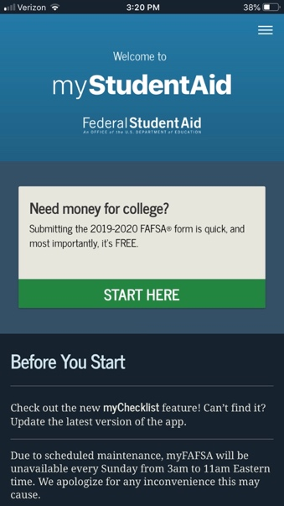
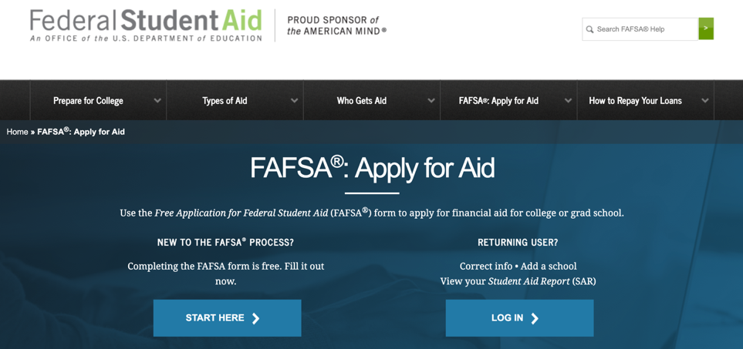
Free Application for Federal Student Aid (FAFSA)
Annual application for most forms of financial aid
Basis for determining eligibility for:
Federal Funds (Grants, Loans and Work Study)
State of Indiana Grants
Some Institutional Funds
Determines EFC
FAFSA.gov
Notes:
Key is FREE
Annual form
Determines EFC – next slide explains

Slide 25
What is EFC?
EFC = Expected Family Contribution
$5K
$0
$816
$10K
$7.5K
OR
$378
$85K
Amount family can reasonably be expected to contribute
Student Income & Assets
Parent(s) Income & Assets
Notes:
Typically looking at “family” income.
This is the number the colleges use to put together the financial aid package.

Slide 26
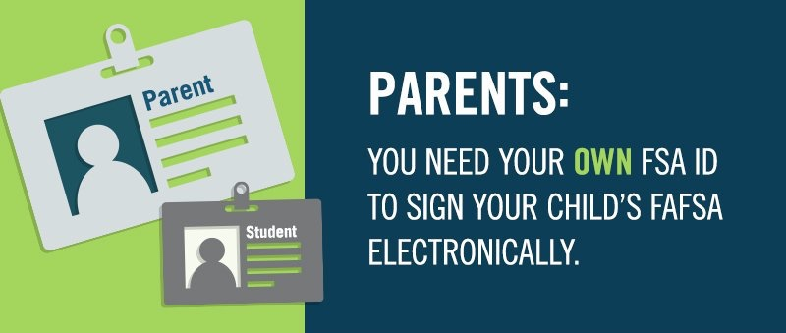
Federal Student Aid (FSA) ID
What is a FSA ID?
Username
Password
Why do I need one?
Confirms your identity
Used to log in to the FAFSA
Serves as your electronic signature
Who needs an FSA ID?
Student &
Parent
Notes:
FSA ID – points – slide emphasizes how to get it and why important (reference that we have a step by step form to help with this process on the resource page of our website)

Slide 27
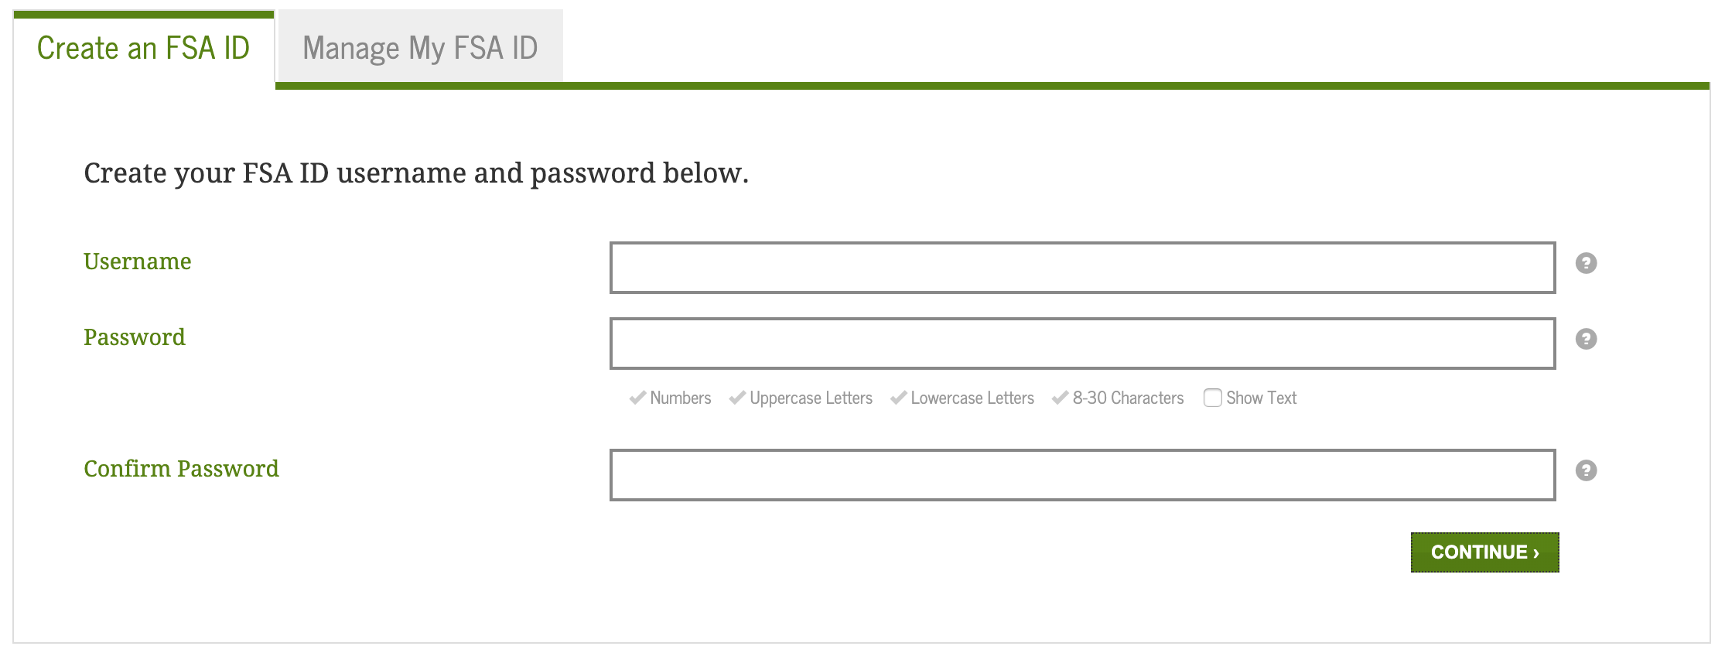
FSA ID
Student & parent can NOT use the same email
Do NOT use high school email address
Must provide a social security number
Required to link email or mobile phone number to account
Notes:
Who needs FSA ID – student and one parent
Email not required, but encouraged. Also must be different for each person.
Strongly encourage students to NOT use their HS email account.

Slide 28
Dependent Questions
Answered from student demographic responses
Born before January 1, 1997
Married
Graduate or professional student
Notes:
Common question is whether parent info is needed – all determined by dependency questions.

Slide 29
Homeless Questions
Initial Question
Three response options
Notes:
Student that designates on the FAFSA dependency question that they are homeless or self supporting and at risk of being homeless has possibly 3 additional questions:
1. High School Homeless Liaison (McKinney Vento)
2. Director of an emergency shelter or HUD transitional housing program
3. Director of a runaway, homeless youth basic center or transitional housing program.
Pick which person has designated them as homeless or at risk of being homeless. Documentation is important in each case.

Slide 30
Dependent Questions
Additional questions
Serving on active duty or veteran of U.S. Armed Forces
Other dependents that you support
Emancipated minor or under legal guardianship
Since turning 13 – have you been in foster care, orphan/ward of the court or both parents deceased
Designated as homeless
Notes:
Common question is whether parent info is needed – all determined by dependency questions.

Slide 31
Homeless Considerations
Homeless Means:
Lack of fixed, regular or adequate housing
You may be homeless if:
Living in shelters, parks, motels, public spaces, cars or abandoned buildings
Temporary living with other people because you have nowhere else to go
Fleeing abusive parent
Notes:
Help and Hints on the page outlines some definitions of homeless:
Lack of fixed, regular or adequate housing
Living in parks, shelters, motels, hotels, public spaces, cars etc.
Couch surfing with friends
Fleeing abusive parents – could get tricky and may require additional documentation and discussion with financial aid administrator

Slide 32
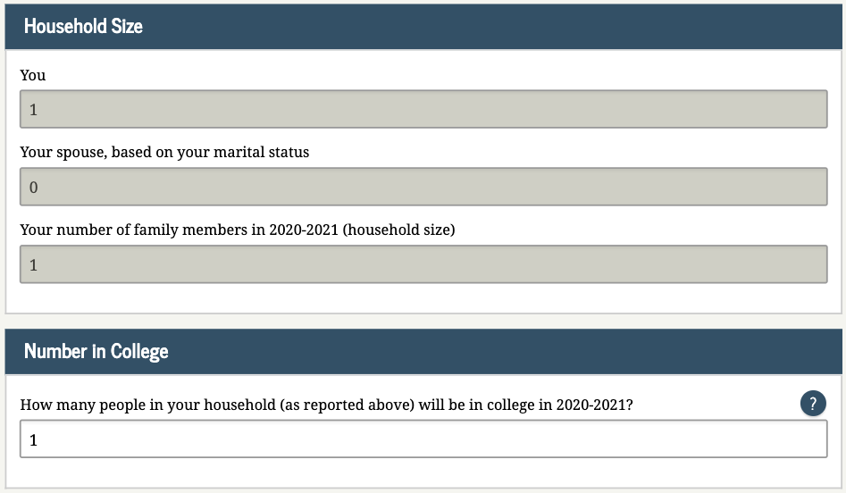
Household & College Numbers
Student answers 1 for each
Notes:
If can answer yes to one of the three options then student indicates number in household and number in college
Common place for an error, especially if living with others.
Since this makes the student independent, they would only list 1 number in household and then 1 in college
If they have a dependent or spouse that they provide half of that person’s support, they would never get to the homeless questions as an earlier dependency question would automatically make them independent.

Slide 33
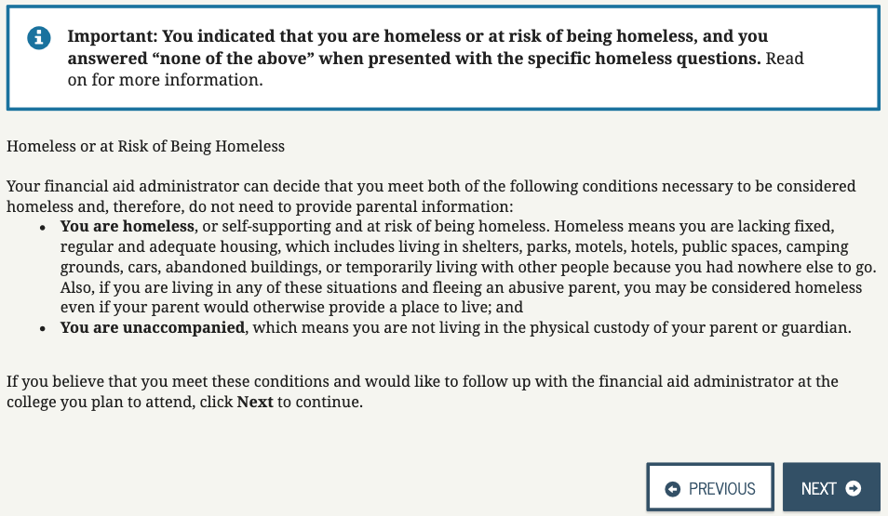
Self-Reporting Homeless Status
Financial aid administrator will determine status
Notes:
If student can not answer yes to one of the initial options they will see this screen. Basically they can elect to continue as self reporting their homeless status and then will need to talk with the Financial Aid Administrator at their college to know how to proceed. They will probably require documentation to determine if the student would meet the criteria. The FA administrator has the last say and may require the student to provide parent information if the determine the student isn’t homeless or self supporting and at risk of being homeless.

Slide 34
Self-Reporting Homeless Status
Warning statement
Final confirmation
Notes:
If student can not answer yes to one of the initial options they will see this screen. Basically they can elect to continue as self reporting their homeless status and then will need to talk with the Financial Aid Administrator at their college to know how to proceed. They will probably require documentation to determine if the student would meet the criteria. The FA administrator has the last say and may require the student to provide parent information if the determine the student isn’t homeless or self supporting and at risk of being homeless.

Slide 35
Documentation & Follow Up
Students should be prepared to provide documentation of homeless designation from:
High School Liaison (McKinney Vento)
Director of Emergency Shelter or HUD
Director of runaway, homeless basic youth center or transitional housing program
Document their situation with their College Financial Aid Administrator if self reporting.
Notes:
Summary – documentation is key
Provide from one of three options or whatever is requested from FA Administrator from college

Slide 36
Aid Implications
If documented appropriately then an Independent Student possibly eligible for:
Federal grants & loans
State grants
Institutional grants & scholarships
If can’t document and can’t provide parent information, student only eligible for:
$5,500 of Unsubsidized Federal Direct Loan as a freshman.
No other federal or state aid
Institutional dependent on each college policy.
Notes:
If appropriate documentation provided then student is independent and eligible for federal, state and institutional aid. If not, then the student has to provide parent info or is only eligible for $5500 in unsubsidized loan.

Slide 37
Who is the Parent?
Biological or adoptive parent
Whose parent information is included on the FAFSA?
Marital Status | Whose information needs provided
Married or unmarried and living together | Both Parents
Divorced, separated or never married | The parent the student lived with more during the past 12 months. If that time is even then provide information for the parent that provided more financial support for the past 12 months.
Remarried after widowed or divorced | Parent and step-parent
Widowed | Single parent
Notes:
Parent starts with biological or adoptive parent
Click shows grid determining who is included based on parent’s marital status
Key in on divorced/separated situations and when a parent remarries!

Slide 38
Homeless Students: College Board Benefits
Karen Bush
Associate Director
College Board

Slide 39
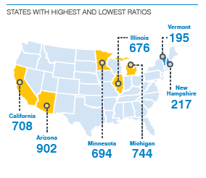
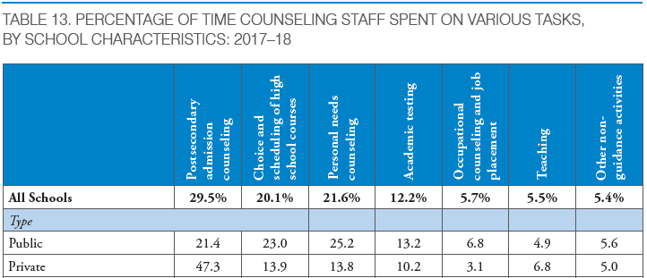
Match vs. Fit
The match vs. fit K-12 conversation
Homeless student challenges
Not enough time, need help from higher ed
Who do they trust with this process

Slide 40
College Board Opportunity Scholarship

Slide 41
Benefits of Free, Official SAT® Practice on Khan Academy
Full Length Practice Tests
Eight official practice tests, with more to come, plus study and test-taking tips
satpractice.org
Video Lessons
Easy-to-follow videos explain problems step-by-step
Interactive Problems & Instant Feedback
Get hints, explanations and constant progress updates to know where you stand
Daily Practice App
More practice available on your phone featuring questions of the day
Notes:
Official SAT Practice through Khan Academy is free to all students
Personalized practice allows diagnostic accuracy when students link accounts
Intuitive interface, and clean design
College Board approved—created by those who write the assessments
Emphasis on skill-building
In-depth explanations of the practice questions
Partnerships with community-based organizations increase accessibility

Slide 42
SAT Fee Waiver Benefits
Free Tests and Free Feedback
2 free SATs, with or without the essay (Grades 11-12)
6 free SAT Subject Tests (Grades 9-12)
Up to three tests in each of two administrations
2 free Question-and-Answer Service (QAS) or Student Answer Service (SAS) reports
College Application Benefits
Unlimited score reports to send to colleges
Waived application fee at participating colleges
Free CSS Profile applications to apply for financial aid from participating colleges
Other Benefits
Fee reductions for score verification reports
No non-U.S. regional fees for free tests (U.S. student testing abroad)
No late registration fees for free tests (in the U.S. or U.S. territories)
Notes:
SAT fee waivers are available to low-income 11th and 12th grade students in the U.S. or U.S. territories. U.S. citizens living outside the country may be able to have test fees waived. SAT Subject Test fee waivers are available for students in grades 9–12.
For those of you unfamiliar with our fee waiver benefits…. Here you can find our list of “bucketed” benefits.
Schools and students reported confusion about what fee waiver benefits were covered so we simplified language.
CSS will be covered later in the presentation
REMIND your audience that fee waivers do not expire. This was a change last year.
As you can see in (INSERT STATE) over (INSERT FW USED) fee waivers were used resulting in a benefit of over (INSERT AMOUNT) for students.
Presenter Note: Refer to 2017-18 FW Usage Data BY STATE document to insert state specific numbers.

Slide 43
SAT Fee Waiver Benefits
For low-income students, the full set of SAT fee waiver benefits will be connected to their College Board online account
SAT national administrations: Students who take the SAT® using a paper fee waiver card will receive the rest of their fee waiver benefits in their online account after their first test sitting
SAT School Day testers: Schools “click” fee waiver–eligible students in an online roster of tested students and students verify eligibility in their online account
Fee waiver balances: Students can see what benefits they still have left by logging in to their online account
What’s new for 2018-19?
SAT fee waiver benefits will be unlocked for students automatically
Notes:
Possible Audience Engagement Questions:
How many of you are responsible for distributing SAT Fee Waivers to eligible students?
There are new updates to how FW-eligible students unlock their benefits.
There should be no cost barrier for students applying to college.
The College Board is working with its members and partners in K-12 and Higher Ed to build on its efforts to remove as many of these barriers as possible for low-income students.
Starting in April 2018, we began making it easier for SAT fee waiver-eligible students to access their full set of SAT fee waiver benefits
Low income students now have their full set of SAT FW benefits connected directly to their CB account.
If a student used an SAT fee waiver on a Saturday national administration, or is identified during school day administration, they will be able to connect with their FW benefits through their account.
Starting in fall 2018, PSAT/NMSQT® fee waiver students will be automatically connected to their full set of SAT fee waiver benefits. (Not true for contract districts)
Since students no longer need to request a paper fee waiver each time that they want to take an SAT or SAT Subject Test, schools will receive a reduced allotment of paper fee waiver cards. You will still be able to order more fee waiver cards, if needed.
PRESENTER NOTE: Refer to SAT Fee Waiver Benefits FAQ and Messaging document for more information

Slide 44
THANK YOU!

