Slide 1
21st Century Scholars College SSP Pilot Campuses
January 30, 2020

Slide 2
Program Milestones
1990
Indiana creates 21st Century Scholars program
1995
First 21st Century Scholars enroll in college
2011
Indiana creates Scholar Success Program
2012
ScholarCorps launches at 10 college campuses (23 in 2018)
2013
Indiana creates credit completion requirements for all state financial aid recipients, including 21st Century Scholars
2015
First Scholars required to graduate high school with a 2.5 GPA
2017
First high school class required to complete Scholar Success Program
2018
State extends Scholar Success Program to college level

Slide 3
Scholar Success Program (High School)

Slide 4
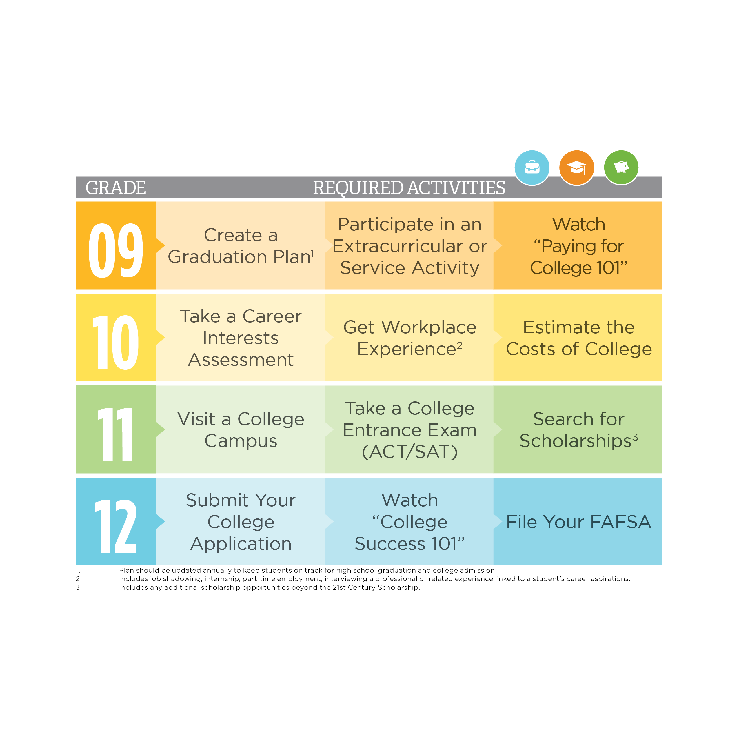
Scholar Success Program
Notes:
Indiana's 21st Century Scholars understand that they have to work hard to succeed in school and to stay on a path to complete college. Beginning with the Class of 2017, Scholars must complete specific steps for each grade level and track their progress using the ScholarTrack Portal. Throughout the 9th-12th grade 21st Century Scholars are required to participate in the Scholar Success Program, also known as SSP.
The Scholar Success Program ensures students understand and complete specific steps that keep them on track to graduate from high school and complete college. These clear expectations for each grade level guide students as they plan their path to high school graduation and beyond, prepare with the skills needed to be college-ready and understand what it takes to pay for college and graduate with minimal debt.
We want to make sure that 21st Century Scholars receive the support they need to plan, prepare and pay for education beyond high school. The Scholar Success Program is designed to guide students every step of the way with practical activities at each grade level.

Slide 5
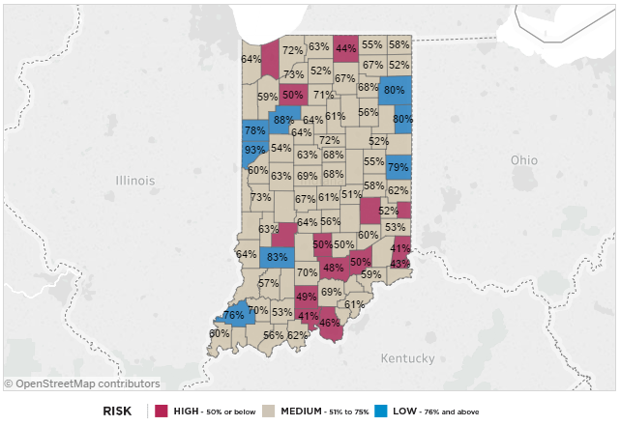
ScholarTrack: June 2017
63% of graduating 2017 Scholars have completed requirements

Slide 6
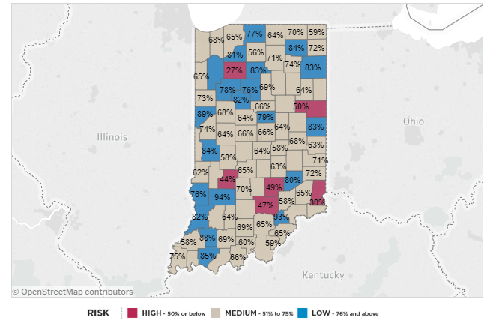
ScholarTrack: June 2018
68% of graduating 2018 Scholars have completed requirements

Slide 7
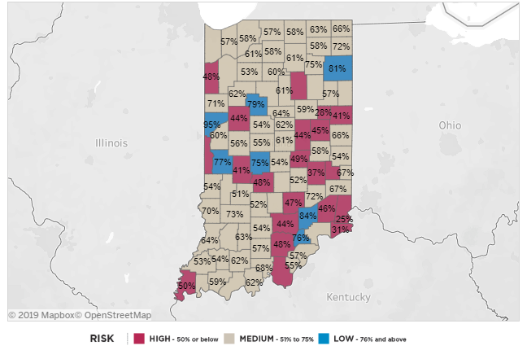
ScholarTrack: April 2019
58% of graduating 2019 Scholars have completed requirements

Slide 8
Historical Context:
Scholars Maintaining Eligibility
SSP
2.5 GPA
% of Scholars Maintaining Eligibility
Notes:
-

Slide 9
Credit Completion

Slide 10
Scholars Now Outpace Students Overall in Credit Completion

Slide 11
College Completion

Slide 12
College Completion for Scholars
Scholars are improving at a greater rate than all other student populations:
Scholars: +7 point increase in one year
All Students: +4 point increase in one year
Notes:
As a response, with the assistance of our Scholar Advisory Committee, the following responses were created.

Slide 13
College Completion for Scholars
Scholars are more likely to graduate on time than their low-income peers
Scholars: 30% on-time grad rate
Other Low-income: 24% on-time grad rate
Notes:
As a response, with the assistance of our Scholar Advisory Committee, the following responses were created.

Slide 14
College Completion for Scholars
Scholars are now more likely to graduate on time at two-year campuses than the overall student population
Scholars: 17% on-time grad rate
Students Overall: 13% on-time grad rate
Scholars are on track to close achievement gap at four-year campuses by/before 2025 (CHE Goal)
Notes:
As a response, with the assistance of our Scholar Advisory Committee, the following responses were created.

Slide 15
Scholar Success Program
(College Level)

Slide 16
Our Charge
CHE: Extend 21st Century Scholar Success Program expectations beyond high school graduation through college completion.
IGA: Begins with Scholars matriculating to an eligible higher education institution after August 31, 2019.

Slide 17
Key Questions
Are these still the right guiding questions?
Is it meaningful?
Is it measurable?
Is it accessible?
What changes would be most impactful at the postsecondary level (and what should it look like)?
Current: Credit Completion, FAFSA, SAP
Format: Annual or cumulative?
Focus: Career Preparation?
Notes:
- Beginning with

Slide 18
Development Process
Analyzing Scholar Data
Reviewing Best-Practice Research
Soliciting Feedback
Notes:
As a response, with the assistance of our Scholar Advisory Committee, the following responses were created.

Slide 19
Best-Practice Research

Slide 20
American Association of Colleges & Universities (AAC&U)

Slide 21
Gallup-Purdue Index
Three strongest contributing factors to alumni well-being:
Graduated from college on time
Had a mentor or professor who made them excited about learning, cared about them as a person
Engaged in deep, experiential learning:
Internship or job,
Long-term school project, or
Extracurricular/service activities
Notes:
- Beginning with

Slide 22
College Feedback

Slide 23
College Feedback
College Advisory Group: Engages representatives from state’s public and private colleges (Student Success & Career Services)
Statewide Campus Survey:
28 Institutions Participated
45 Campus Responses

Slide 24
Key Questions
Where do we need to focus?
What should be included (required)?
Which do campuses currently offer?
How will we track completion and ensure quality?
Are there other considerations?

Slide 25
Proposed Goals / Focus Areas
College Readiness: Smooth transition from high school to college, build self-efficacy skills and strengthen connections to campus resources.
College Performance: Ensure students perform academically and stay on track to complete college.
Career Readiness: Build employability skills and smooth transition from education to employment.

Slide 26
Survey Findings
Consensus: Majority (89%) of respondents agreed that proposed categories were the right focus areas
Capacity: Every campus offers multiple activities in each category for students to satisfy potential requirements (Intentionality is key.)
Clarity: Respondents expressed a need to clarify campus expectations and participant outcomes.

Slide 27
Survey Findings (continued)
Related Competencies: Survey respondents offered other suggestions for inclusion:
Cultural Competency
Dealing with Mental Health
Financial Literacy
Relationship Health
Study Skills
Time Management

Slide 28
Potential Requirements
(Draft 1)

Slide 29
Proposed Requirements Summary
COLLEGE READINESS | COLLEGE PERFORMANCE | CAREER READINESS
REQUIRED
Summer Bridge Program, First-Year Experience, AND/OR Living-Learning Community | Credit Completion AND Satisfactory Academic Progress (SAP) | Work-Based, Research-Based, AND/OR Service-Based Learning Experience
RECOMMENDED
Campus/Faculty Mentor | Academic Advising/ Tutoring | Career Advising/ Capstone Experience

Slide 30
Potential Requirements
(Draft 2)

Slide 31
Proposed Requirements Summary
COLLEGE PERFORMANCE | COLLEGE ENGAGEMENT | CAREER PREPARATION
ALL 3 ANNUALLY | 1+ PER YEAR | 1+ PER YEAR
Complete 30 Credits Per Year Maintain SAP File FAFSA | Summer Bridge Program AND/OR New Student Orientation First Year Experience AND/OR Living-Learning Community Campus Involvement AND/OR Student-Faculty Research | Informational Interview AND/OR Job Shadow Internship (Work-Based and/or Service-Based Learning Experience) Professional Résumé (posted on LinkedIn)
Scholar Success Mentor/Advisor

Slide 32
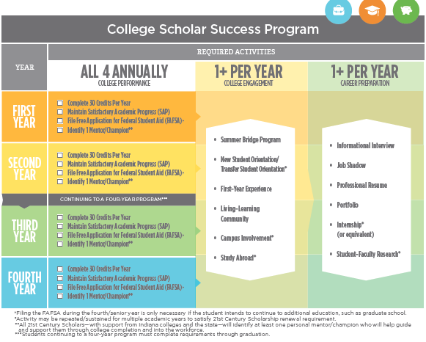
Final Version

Slide 33
Scholar Success Mentor/Advisor
All 21st Century Scholars—with support from Indiana colleges and the state—will identify at least one campus- and/or community-based mentor/advisor who will help guide them through college completion and into the workforce.

Slide 34
College Engagement
Summer Bridge Program - Summer bridge programs provide students with academic and social experiences over the summer between high school and college.
New/Transfer Student Orientation* - Orientation is usually a day or weekend program where new students are able to learn their way around campus, create their first semester schedule and connect with other students.
First Year Experience/Seminar - A first-year experience or seminar is designed to help ease the transition from high school to college by providing social and academic experience—generally during the first semester of school.

Slide 35
College Engagement
Learning Community - Learning communities are specialized living environments that help students connect inside and outside the classroom.
Campus Involvement* - Campus involvement encompasses many different ways that you have interacted with and have become engaged on campus—such as intramural sports, clubs, or service events.
Study Abroad* - Study abroad is a program that allows you to complete part of your degree away from your campus – on another campus in the United States or in another country.

Slide 36
Career Preparation
Informational Interview - An informational interview is a way to learn more about a career you’re interested in by talking with and asking questions from someone who is working in that field.
Job Shadow - A job shadow is a time where you to follow around an individual in a position or profession you’re interested in to learn more about what that entails.
Professional Resume - A professional resume is a document used to share your education and experience with a potential employer.

Slide 37
Career Preparation
Portfolio - A portfolio is a compilation of documents that gives you an opportunity to highlight examples of your academic work that’s relevant to your major and career path.
Internship* - An internship is a structured and supervised opportunity that provides you with practical experiences in a career field.
Student-Faculty Research* - Student-faculty research is an activity where a student and faculty connect to research a topic of interest. It is generally for credit, but can be extracurricular as well.

Slide 38
ScholarTrack

Slide 39
ScholarTrack

Slide 40
ScholarTrack

Slide 41
ScholarTrack

Slide 42
ScholarTrack

Slide 43
ScholarTrack

Slide 44
Proposed Implementation Timeline
Spring/Summer 2018: Develop/Vet Requirements
Fall 2018 (August): Requirements Finalized
Fall 2018/Spring 2019: System Development
(ScholarTrack)
Fall 2019/Spring 2020: Campus Pilot
Fall 2020/Spring 2021: Statewide Implementation

Slide 45
Questions

Slide 46
Jarod Wilson
Director, Postsecondary Outreach and Career Transitions
jwilson@che.in.gov

