Slide 1
ISFAA Winter Conference 2018
Colby Shank & Catherine Carver
January 25^{th,} 2018 and January 26th, 2018

Slide 2
Agenda
ScholarTrack
    Edit Overrides & the Overrides File
    ISIR Overrides & ISIR Transaction Logic
    New Features in ScholarTrack
    Reporting Credit Completion and Credit Bank Data
    Payments
    ISIR Requests
    State Aid Usage Widget
Financial Aid Manual
      MDEGS
      Enrollment requirements
      Residency Requirements
      Claims

Slide 3
Edit Overrides & the Overrides File

Slide 4
Edit Overrides
Which Edits can a college user override?
  Edit 03: Not a first-time undergraduate.
  Edit 11: Not a U.S. Citizen or Eligible Non-citizen.*
  Edit 17: Default on federal student loan and/or overpayment of federal grant.
  Edit 22: Mailing address not IN and no edit 02.
  Edit 28: Independent status caused by Emancipated Minor or In Legal Guardianship status.
  *Starting with 2018-2019 ISIRs.

Slide 5
Overrides File
Can use the new ISIR override file to upload students in bulk who need certain edits overridden on their ISIR.
Set a student or CPS transaction as a School transaction.
Can also set the Associate Degree Flag.

Slide 6
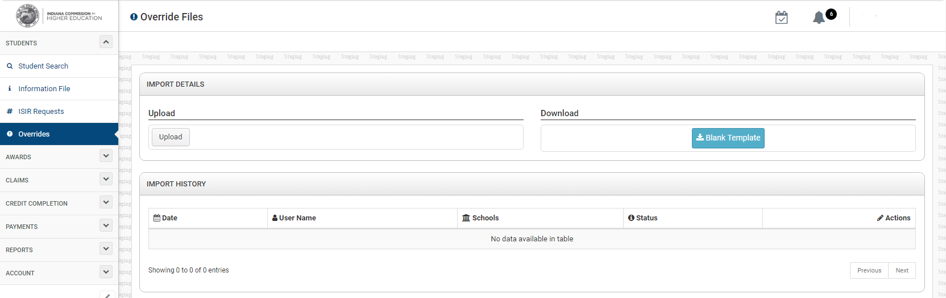
Overrides File

Slide 7
ISIR Overrides &
ISIR Transaction Logic

Slide 8
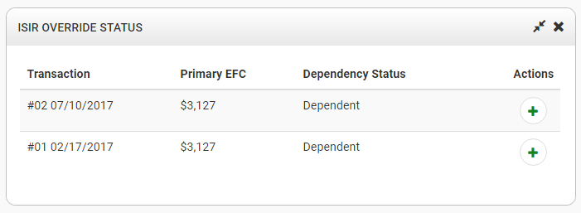
ISIR Overrides
How do I select a different ISIR for EFC and Dependency Status?
  ISIR Override Status Widget
  Note that if a transaction is a school transaction or the transaction does not contain a Primary EFC, you won’t be able to select that transaction in the ISIR override process.

Slide 9
ISIR Transaction Logic
How does ScholarTrack determine which ISIR transaction to use in determining edits?
  For most edits, the latest ISIR transaction will always be used. This applies to edits 02, 03, 08, 11, 17, 22, 29.
  For other edits, we use the latest school or overridden ISIR transaction. If no school or overridden ISIR transactions exist, we use the latest ISIR transaction. This applies to edits 05, 14, 20, 25, 28.

Slide 10
ISIR Transaction Logic
How does ScholarTrack determine which ISIR transaction to use in determining EFC and Dependency Status?
  We use the latest school or overridden ISIR transaction.
  If no school or overridden ISIR transaction exists, we use the latest student or CPS ISIR transaction.

Slide 11
New Features in ScholarTrack

Slide 12
Scheduling Files
You can now schedule Information Files, Credit Completion Files, Credit Bank Files, and Claim Files.
You can schedule a one-time file or you can schedule them on a recurring basis.

Slide 13
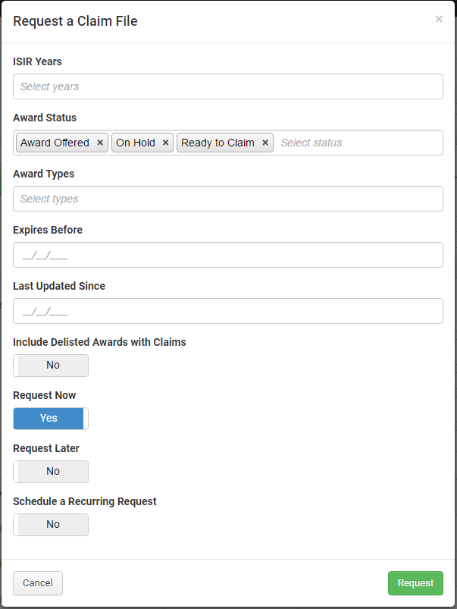
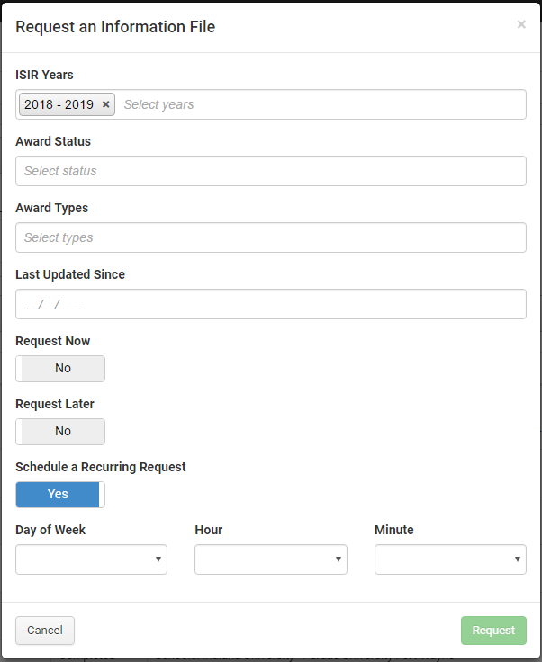
Scheduling Files

Slide 14
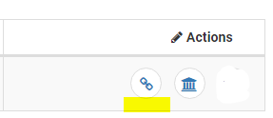
Impersonating a Student User
College users will soon have the ability to impersonate a student and view a student account to better assist students with navigating state financial aid processes.
You can impersonate the student by searching for them and clicking on the link symbol under Actions:

Slide 15
Reporting Credit Completion and Credit Bank Data

Slide 16
Reporting Credit Completion Data
When should Credit Completion Data be reported in ScholarTrack?
  Report this data no later than two (2) weeks after grades are posted for the term at your institution.
  Report for all students on your file – even if they no longer attend or have never attended your institution. Blank Record = Not Reported.
  As grades change for students (grade appeals, incompletes, etc.), report updated hours for past terms.
  Be responsive to student requests.

Slide 17
Reporting Credit Bank Data
Who should report Credit Bank hours?
  The institution where hours were earned (Dual Credits) should report the hours.
  If AP/IB credits are awarded by an institution, the institution awarding those credits should report the hours.

Slide 18
Payments

Slide 19
Invoices and Payment Processing
If your net claim balance is positive (we owe you $$), we process payments each week and make your payments a priority.
If your net claim balance is negative (you owe us $$), we will wait for additional claims instead of processing refund requests.
We will generate refund requests at the end of each quarter if your balance remains negative.

Slide 20
ISIR Requests

Slide 21
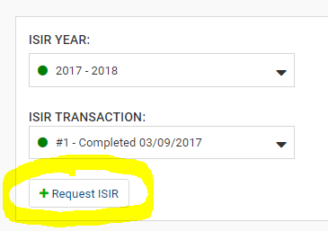
Requesting ISIRs in ScholarTrack
From the student details page:

Slide 22
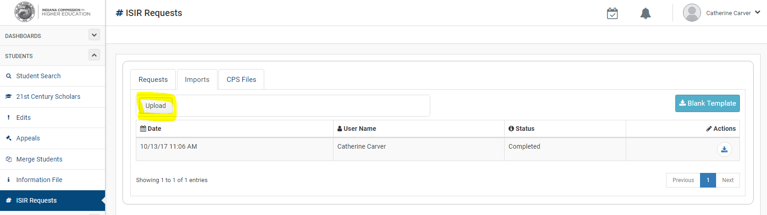
Requesting ISIRs in ScholarTrack
From the ISIR Requests Page:
  You have the ability to upload a file of students for whom you know that ISIR transactions are missing. This will get sent to CPS on a weekly basis.

Slide 23
State Aid Usage Widget

Slide 24
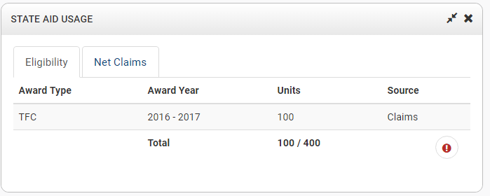
State Aid Usage Widget- Eligibility

Slide 25
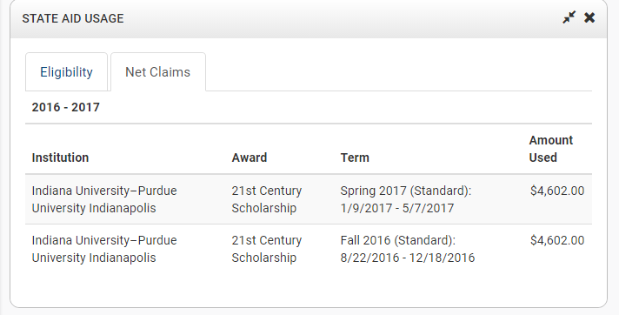
State Aid Usage Widget- Net Claims

Slide 26
Financial Aid Manual

Slide 27
Questions about the Financial Aid Manual
Mitch Daniels Early Graduation Scholarship
  Claiming: Full amount should be claimed in Fall term. Any funds not credited to tuition and fees must be remitted to student.
  Refunds: MDEGS should not be refunded unless it is discovered that the student was not eligible to receive the award. For example, student was not full-time or degree-seeking. Only refund entire amount.

Slide 28
Questions about the Financial Aid Manual
Enrollment requirements
  Students must either be enrolled full-time on the state financial aid census date OR they must be enrolled full-time on the last day of the term to be eligible for most state financial aid.
  If they are enrolled full-time by the census date and withdraw afterward, they are still eligible for their funds if eligible tuition and fee charges exist.

Slide 29
Questions about the Financial Aid Manual
Residency Requirements
  Dependent students and their parents listed on the FAFSA must be domiciled in Indiana on December 31 of the calendar year immediately preceding the award year to receive the scholarship, and students must remain living in the state thereafter.
  The parents listed on the FAFSA do not need to remain living in Indiana. Once dependent students use a state financial aid award, they have established residency for state financial aid purposes. In subsequent award years, only the students’ residency is considered for eligibility purposes.

Slide 30
Questions about the Financial Aid Manual
Claims and Refunds
  Institutions are limited to claiming 50% of the remaining balance of certain award types for the first term claimed of the award year.
  The 50% restriction applies to the following award types: Frank O’Bannon Grant, 21st Century Scholarship, Adult Student Grant, William A. Crawford Minority Teacher Scholarship, and Next Generation Hoosier Educators Scholarship.
  Institutions may claim up to the remaining balance of the award offer in subsequent terms.

Slide 31
Questions about the Financial Aid Manual
Final 50 units of eligibility
  If a student has 50 eligibility units remaining, but it is not their final term:
    The award should still be treated as an annual award, where 50% of the award is claimed in the first term, and the remaining balance is claimed in a subsequent term.

Slide 32
Questions about the Financial Aid Manual
Summer Usage:
  Institutions may claim up to 100% of a student’s 21st Century Scholarship or Frank O’Bannon Grant during the summer if the student was enrolled full-time during all prior terms of the award year.

Slide 33
Questions about the Financial Aid Manual
Final Term Claims:
  Institutions may claim up to the remaining balance of the award offer in the first term of the award year if the student is in the final term of his or her academic degree program.
  Simply use the ‘Final Term’ flag when claiming and this will allow a claim of more than 50%.

Slide 34
Questions?

