Slide 1
Developing an Office Operational Calendar
And Other organizational tools
Winter Conference 2017

Slide 2
Operational Calendar
Benefits
Developing
Maintaining
Other Organizational Tools
Winter Conference 2017

Slide 3
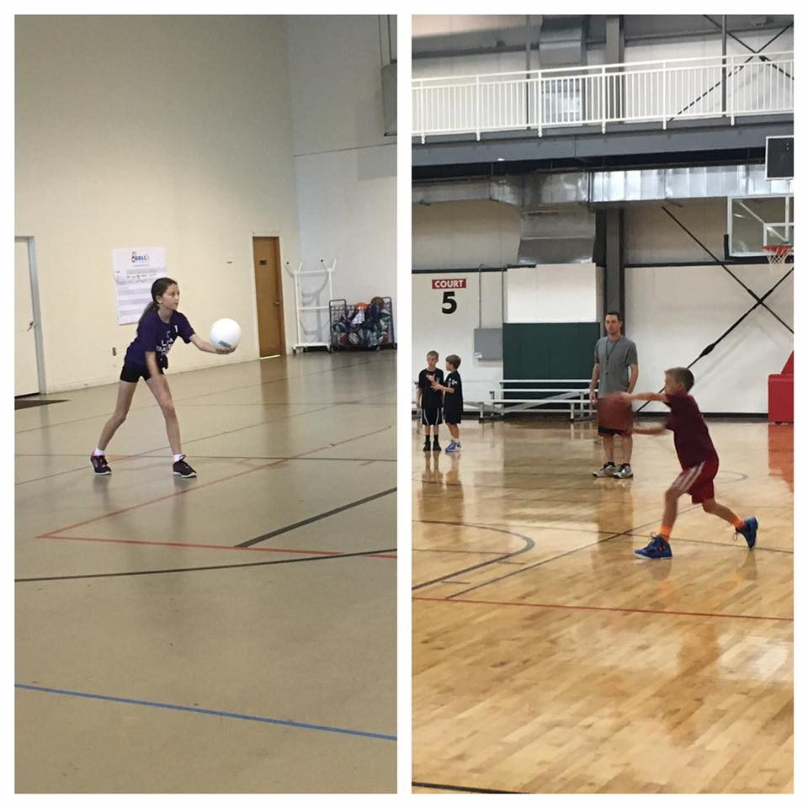
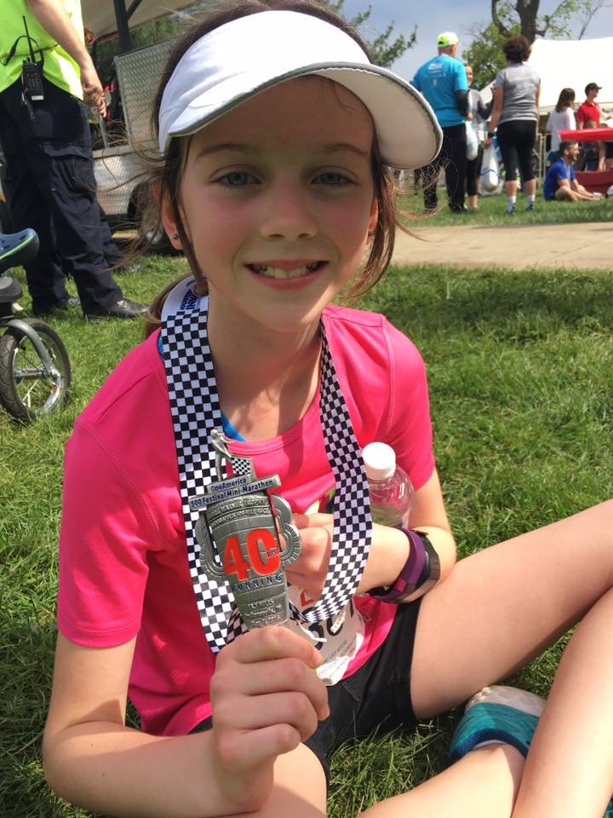
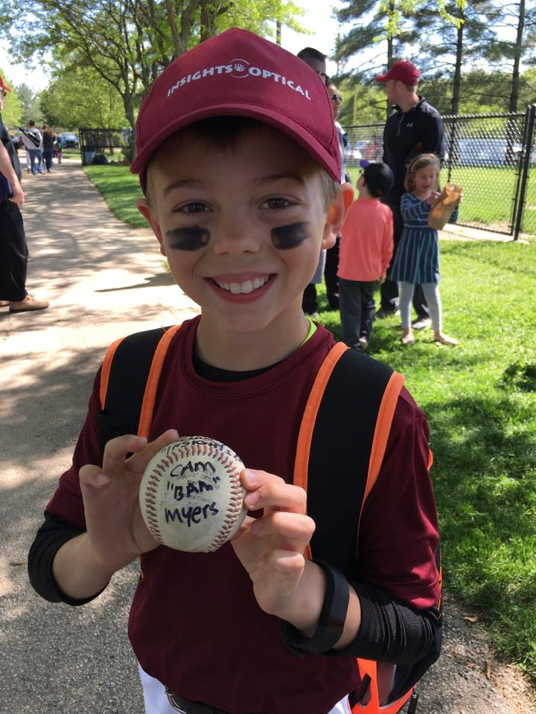
Winter Conference 2017

Slide 4
Benefits of Being Organized
Relevant dates, tasks, deadlines are consolidated in a single document
Reduce missed deadlines or last minute rush to meet deadlines
Staff are informed and accountable for assignments
Financial Aid is very cyclical
We are often doing the same tasks at around the same time each year….but might only do that task once a year so it’s not always on our minds.
Winter Conference 2017

Slide 5
Developing Your Calendar
Format
Email Calendar with recurring appointments
Could send reminders to responsible staff
SharePoint
Excel
Paper?
Dry Erase Board
Others?
Winter Conference 2017

Slide 6
Developing Your Calendar
Identify tasks and dates
Staff input
Area calendars
Managers meeting
Just FA office tasks/dates? Other institutional dates?
Can take an entire year to get it completely populated
Winter Conference 2017

Slide 7
Items for the Operational Calendar
Admin tasks
Annual FA cycle tasks
Communication tasks
Award Notifications
Emails to Students
Outreach dates
Incoming Student Programs
Campus Partner Training
Staff Meetings
System setup
Reports to management
Finalizing off-campus contracts for work-study
Voter Registration notification
Winter Conference 2017

Slide 8
Items for the Operational Calendar
Fire Safety Report
Annual Updates for the website
Annual updates for consumer information
Due dates for timesheets
Gainful employment reporting
Net Price Calculator updates
NCAA reporting
Retreat
Staff birthday!!!! Of course – cake!
Disbursement dates
Refund dates
What else?????
Winter Conference 2017

Slide 9
Maintaining Your Calendar
Who is responsible?
IUB process
Monthly meetings near the end of each month to discuss and assign items for the next month
Keeps everyone on the same page and encourages accountability for tasks
Create a culture of adding dates to the calendar
Outlook calendar with events setup as recurring annually
Winter Conference 2017

Slide 10
Other Organizational Tools
Audit Inventory
Location
Start/End Dates
Start on 1st of the month.
Helpful to have audits begin at the 1st of the month rather than rolling throughout the year. Fewer dates to manage.
Link to processing guide/instructions
Responsible area
Reviewed at monthly calendar review meeting
Naming Conventions
Implement consistent naming conventions across all areas of the office
Audits > Awarding > 21st Century Covenant
Used in policy and instructional documentation, inventory and saved audit output
Winter Conference 2017

Slide 11
Other Organizational Tools
Audit Inventory
 | AUDIT NAME | PROCESSING AREAS | AUDIT ORIGIN | AUDIT TERM | RUN SCHEDULE | AUDIT START DATE | # OF MONTHS RUNNING | AUDIT END DATE | STOP DATE | SOP LAST UPDATED | OWNER LOCATION
APPEALS
 | 16AY APPEAL AUDIT | APPEALS | IUIE | AY | DAILY | 5/1/2015 | 13 | 6/30/16 | June-16
 | 16SU APPEAL AUDIT | APPEALS | IUIE | SU | WEDNESDAY | 5/1/2016 | 3 | 8/31/16 | August-16
 | 17AY APPEAL AUDIT | APPEALS | IUIE | AY | DAILY | 5/1/2016 | 13 | 6/30/17 | June-17
 | 17SU APPEAL AUDIT | APPEALS | IUIE | SU | WEDNESDAY | 5/1/2017 | 3 | 8/31/17 | August-17
 | 18AY APPEAL AUDIT | APPEALS | IUIE | AY | DAILY | 5/1/2017 | 13 | 6/30/18 | June-18
AWARDING
 | 18AY AWARDING AUDIT | AWARDING | SCRATCH | AY | WEDNESDAY | 2/1/2017 | 15 | 5/31/18 | May-18
Winter Conference 2017

Slide 12
Other Organizational Tools
Email Inventory
Start/End Dates
Population
Email Text
Responsible Party
Reviewed at monthly calendar meetings
Winter Conference 2017

Slide 13
Other Organizational Tools
Email Inventory
 | EMAIL TITLE | PROCESSING AREA | POPULATION ORIGIN | QUERY LOCATION | READY BY DATE - TEXT | READY BY DATE - POP | GENERATION | START DATE | STOP DATE | RESPONSIBLE
APPEALS
 | TITLE - TERM - AY | APPEALS | IUIE | IE_SIS_FA_CHKL_CD | MM/DD/YY | MM/DD/YY | MANUAL | MM/DD/YY | MM/DD/YY
AWARDING
 | TITLE - TERM - AY | AWARDING | SQL | DRIVE:/FOLDER/AY/TERM/QUERY NAME | MM/DD/YY | MM/DD/YY | MANUAL | MM/DD/YY | MM/DD/YY
SYSTEMS
 | TITLE - TERM - AY | SYSTEMS | SQL | DRIVE:/FOLDER/AY/TERM/QUERY NAME | MM/DD/YY | MM/DD/YY | AUTO | MM/DD/YY | MM/DD/YY
Winter Conference 2017

