Slide 1

Combining Financial Aid & Financial Literacy to Reduce Student Debt
Phil Schuman, Director of Financial Literacy
Janessa Siegel, Program Coordinator of Financial Literacy

Slide 2
About the
Office of Financial Literacy
Administrative body behind some of the changes to FA business practices and required component
3 FTE, 2 Research from SPH, ~10 students
Provides Financial Education for all 8 campus, 114,000 students
Collaborates with liaisons/teams from all IU campuses to implement effective programming

Slide 4

Indiana University MoneySmarts
Program History
Move to holistic training of MoneySmarts Team
Development of faculty/staff/alumni resources
Rebrand of moneysmarts.iu.edu
Creation of IU MoneySmarts Team
First marketing campaign: debt monster
Research partnership with School of Public Health
Development of Student Cost Calculator
Student debt task force
Launch of
moneysmarts.iu.edu
Regional expansion of MoneySmarts Team
2012
2013
2014
2015
2016
2017
Formation of National Summit on Collegiate Financial Wellness
Creation of WellBeing Consultant
Establishment of office
Required financial literacy for 1st year students
We moved to a place where students go!!!
Development of Student Cost Calculator
Partnerships with campus offices/liaisons
Participation in Professional Fellows Program, Aztrakhan, Russia
“MoneySmarts U”
Launch
Higher Education Financial Wellness Summit
Notes:
Phil

Slide 5

$98.7 million
Reduction in undergrad student borrowing since 2012 (15%)

Slide 6
Financial Wellness

Slide 7
Financial Education: Challenges
Financial education is not exciting
Student debt is rising
Students are not aware of their borrowing levels or even the fact that they are borrowing
Difficult to provide meaningful interventions
Programming does not reach all students
How do we know what students want and what they will consume?
How can we help students understand the importance of engaging now?

Slide 8
The research

Slide 9
60%
Finances & Stress
40%
79%
33%
First Year Students say they are frequently worried about their financial situation
of students are Concerned/Very Concerned about their ability to pay for next years education expenses
of students say they frequently worry about debt
students described their finances as “traumatic” or “very difficult”

Slide 10
25%
Effect of Financial Strain on Students
80%
20+
40%
  Of students said they did not purchase required academic materials because they didn’t want to take out extra loans
  of students who self-reported being “financially stressed” say concerns frequently affected academic performance and/or investigated dropping out
  Number of hours worked/week that negatively effects GPA
  Report investigating working more to meet expenses

Slide 11
40%
Effect of Financial Strain on Students
49%
34%
23%
  Said they did not participate in an activity because of finances
  Worry about meeting monthly expenses
Say the amount of debt causes them a large or extreme amount of stress
Are not confident they can pay off the amount they’ve borrowed

Slide 12
EXPECTATIONS GAP

Slide 13
Get them in touch with their reality

Slide 14
42%
Of college seniors expect
to earn more than $50,000
in their 1st job out of college
Source: USA Today

Slide 15
23%
Of employers actually pay
this amount
Source: USA Today

Slide 16
Tuition & Fees
+ Room & Board
+ Books & Supplies
+ Transportation
+ Personal
+ Opportunity Cost of employment
= $50,000 or more cost of extra year

Slide 17
Types of interventions

Slide 18
Required Financial Literacy
Upcoming: Financial Literacy Platform

Slide 19


MoneySmarts U
Replacement to Transit beginning in Fall 2017
Partnership with financial expert Pete the Planner and Office of Online Education
Broken into 7 modules providing information targeted for specific time in a student’s life
  Including high school students and recent graduates
Platform will be available to other universities/institutions across the country

Slide 20
Click here to learn more about MoneySmarts U

Slide 21
IU MoneySmarts Team

Slide 22
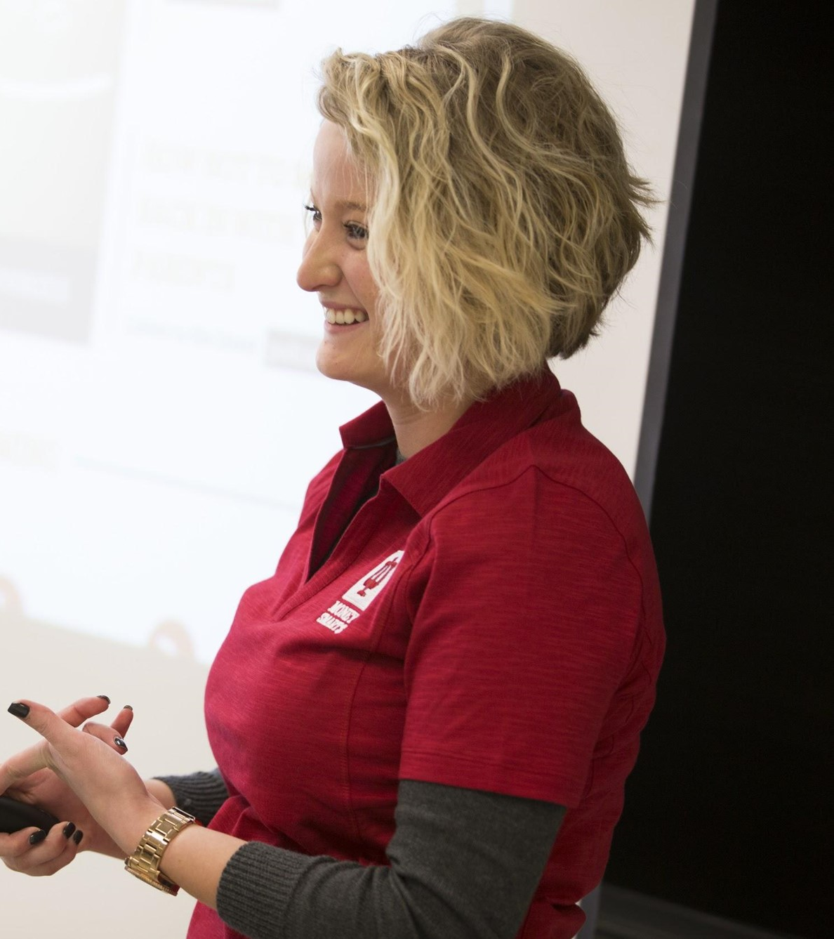
IU MoneySmarts Team
One on one/group appointments for students & student organizations
Students learn from those with whom they most identify
2015-2016:
- 260 one-on-ones conducted in 2015 -16
- More than 2,000 students reached via
presentations in 2015 - 16
Expanding to regional campuses and online

Slide 23
Effects of Peer to Peer
Financial Education
Fall 2016: Student Stress Levels Before and After Appointment
Level of stress | 1 | % | 2 | % | 3 | % | 4 | % | 5 | % | 6 | % | Total
Before | 6.25% | 5 | 21.25% | 17 | 27.50% | 22 | 20.00% | 16 | 15.00% | 12 | 10.00% | 8 | 79
After | 31.25% | 25 | 37.50% | 30 | 13.75% | 11 | 8.75% | 7 | 7.50% | 6 | 1.25% | 1 | 79
Fall 2016: Student Responses to Appointments
Answer | % | Count
Very beneficial | 48.75% | 39
Beneficial | 47.50% | 37
Neutral | 3.75% | 3
Not beneficial | 0.00% | 0
Total | 100% | 79

Slide 24
moneysmarts.iu.edu

Slide 25
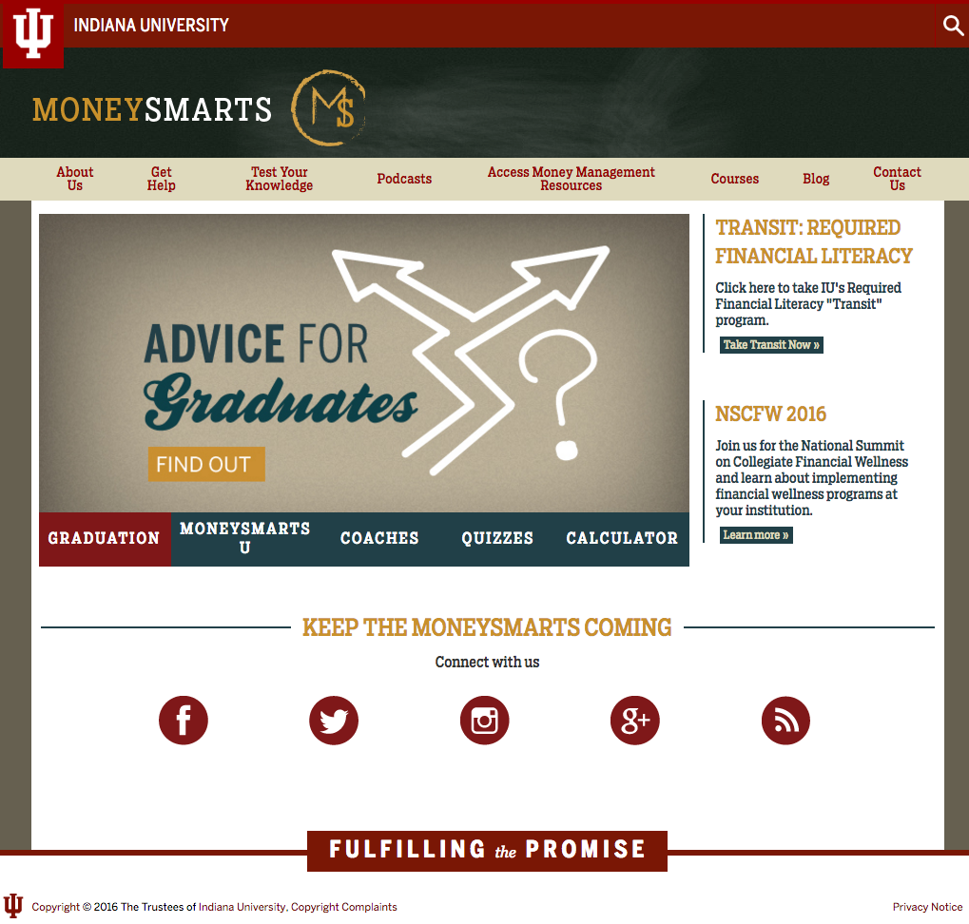

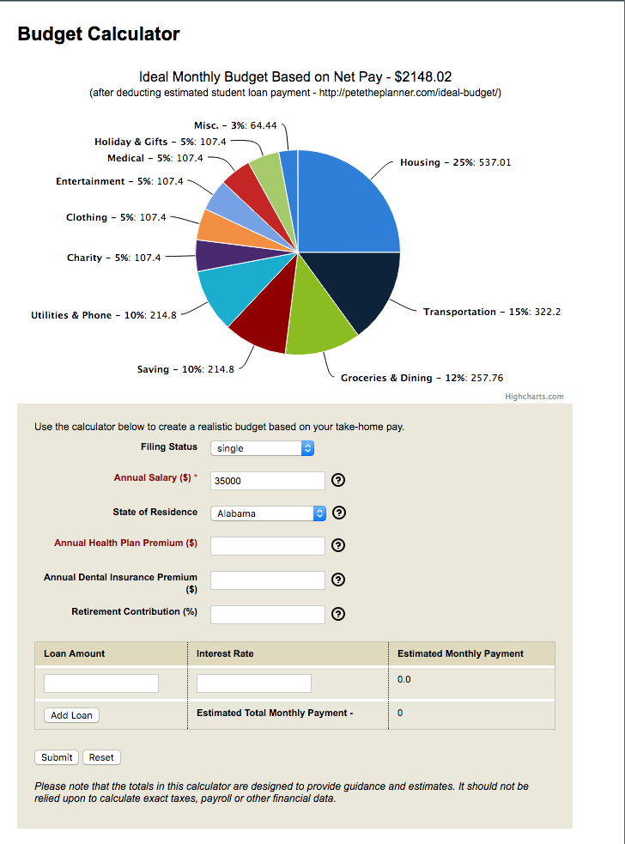
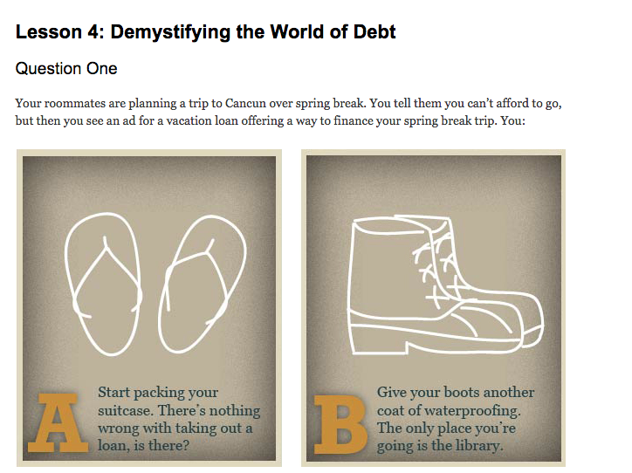
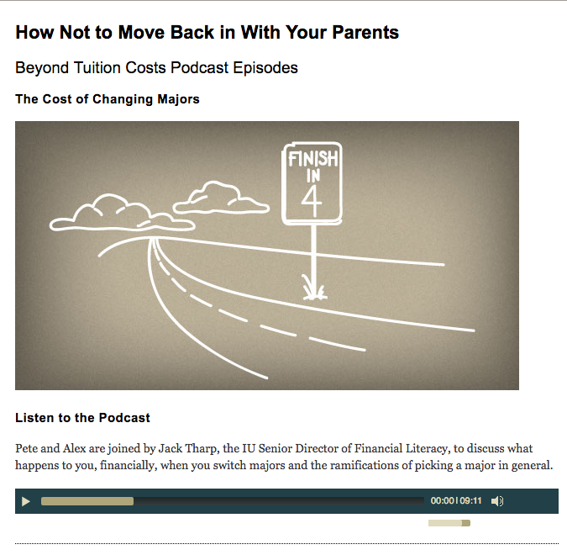
moneysmarts.iu.edu

Slide 26
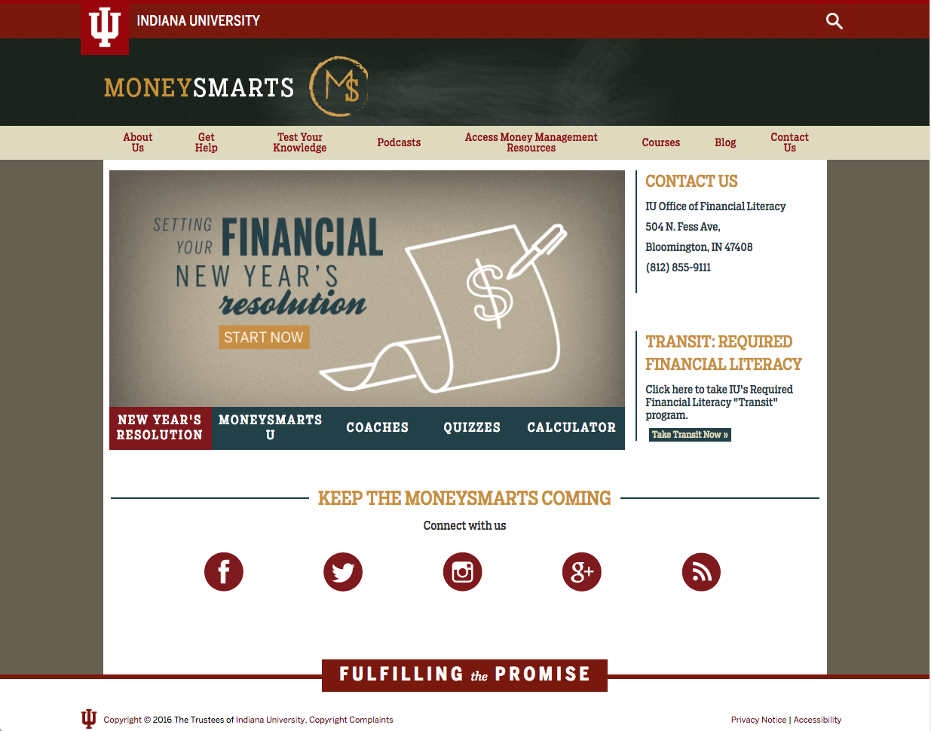
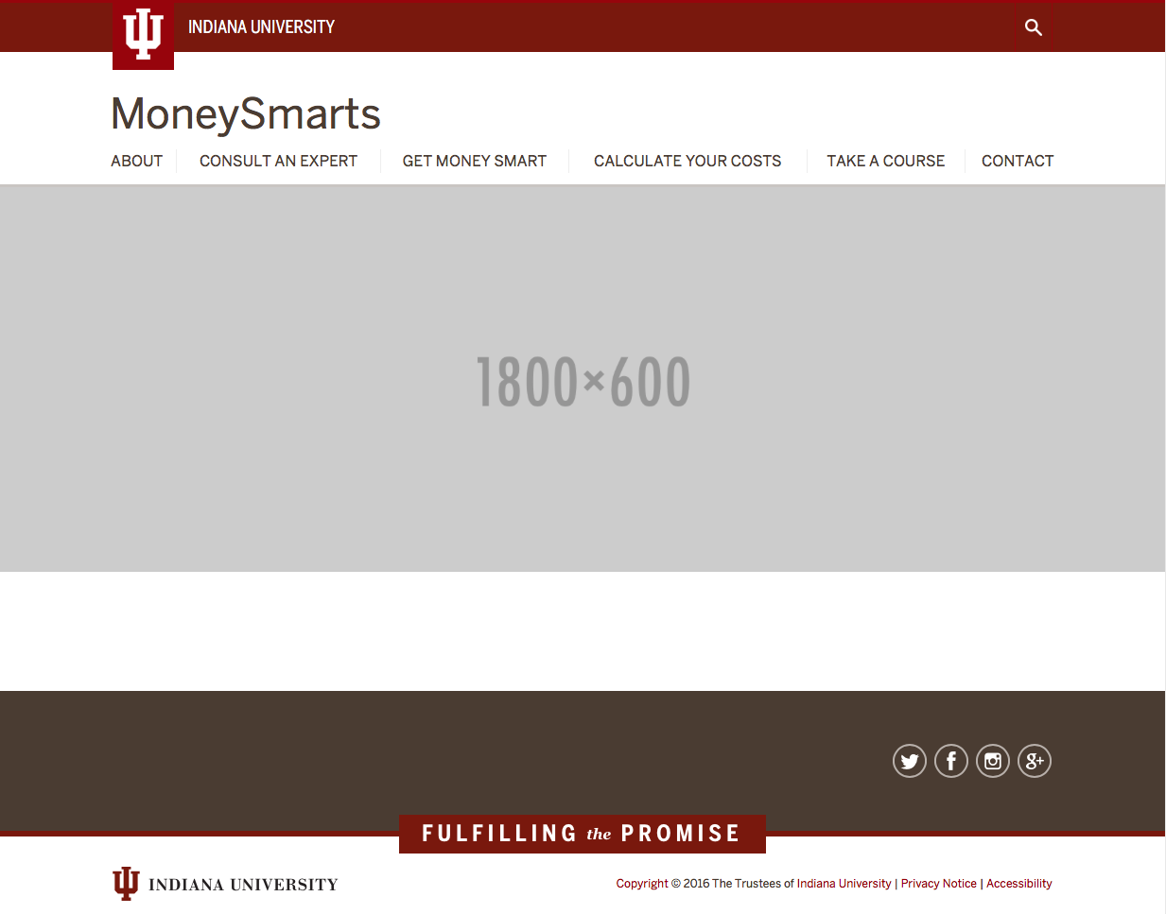
MoneySmarts.iu.edu redesign

Slide 27

Student Cost Calculator
Help students/parents estimate their cost of college
Real-time feedback on costs based on their decisions
Provide links to tools to help students learn how to lower their costs

Slide 28
Higher Education Financial Wellness Summit
Conference founded in 2014 to promote financial wellness across higher education
2016 saw 280 attendees from 39 states, DC, and Canada
175 institutions represented
July 30 – August 1, 2017 – University of Minnesota

Slide 29
Questions?
Phil Schuman
Director of Financial Literacy
phaschum@iu.edu
Janessa Siegel
Financial Literacy Program Coordinator
janesieg@iu.edu

