Slide 1
Financial Literacy and Behavior Change
Helen Colby, Ph.D.
Indiana University, Kelley School of Business

Slide 2
Overview
Effectiveness of financial education and training
Unexpected effects of financial literacy education
Predictors of positive financial behavior
New methods

Slide 3
Knowledge and Attitudes Versus Behaviors
Many financial literacy interventions use knowledge as an outcome measure
  Knowledge change is, relatively, easy
Others use attitude changes
  Real attitude change is hard, measured attitude change is less hard
Assumption was that these lead to behavior change

Slide 4
Effectiveness of Financial Education
Meta analysis
168 published papers
201 separate studies
How effective is financial education at changing behaviors?
Fernandes, Lynch, & Netemeyer (2013)

Slide 5
Financial education interventions accounted for 0.1% of the variance in behaviors.

Slide 6
What Was Included?
Controlled experiments
Pre and post tests
Students, adults, low-income, higher-income
Workshops, seminars, courses, fliers
Voluntary and required

Slide 7
What Was Included?
Wide variety of behaviors
  Debt
  Investing
  Saving
  Planning
One Hour to 24 Hours of Instruction
  Mean = 9.7 hours
Immediate to 24 months after Intervention
  Mean = 11 months

Slide 8
Time Effects
Effects decayed significantly over time
No effect of 24 hours of instruction at 18 months

Slide 9
General Financial Knowledge
Meta analysis
Current financial knowledge
No intervention

Slide 10
General financial knowledge accounted for 1.8% of the variance in behaviors.

Slide 11
Effect of Income
Financial education was even less effective at changing behavior for lower-income individuals
Financial knowledge was also less predictive of behavior
Opportunities, constraints, environmental effects

Slide 12
Why is financial literacy training ineffective?

Slide 13
Explicit vs. Implicit Attitudes
Explicit Attitudes – admitted, open
Implicit Attitudes – may not even know oneself

Slide 14
How to Measure Implicit Attitudes?
Implicit Association Test
Reaction time measure of implicit associations and attitudes
Greenwald, McGhee, & Schwartz (1998)

Slide 15

Good
Black American
Bad
White American

Slide 16

Good
White American
Bad
Black American

Slide 17
How to Measure Implicit Attitudes?
Used to study race, gender, obesity, and many others
Financial attitudes?
Greenwald, McGhee, & Schwartz (1998)

Slide 18
Good
Spend
Bad
Save
Purchase

Slide 19
Good
Save
Bad
Spend
Thrift

Slide 20
Spending/Saving IAT
Spending
Spend
Buy
Purchase
Splurge
Shop
Saving
Save
Thrift
Frugal
Budget
Economize
Good
Marvelous
Superb
Pleasure
Joyful
Wonderful
Bad
Horrible
Agony
Painful
Terrible
Awful

Slide 21
Study 1: Implicit Attitudes and Financial Stress
Completed Spending/Saving IAT
Completed a battery of financial health questions

Slide 22
Study 1: Results
Mean Rating

Slide 23
Study 1: Results
Also significant differences on:
InCharge Financial Distress/Financial Well-Being Scale
Impulsive Buying Scale
Like/Dislike Savings
No significant differences in income or education

Slide 24
Study 2: Effects of Financial Literacy Training
1. Spending/Saving IAT
2. Explicit Questions
3. Financial Literacy Training
4. Explicit Questions Repeated
5. Spending/Saving IAT Repeated

Slide 25
Study 2: Explicit vs. Implicit Attitudes
Prefer Saving
Mean Rating
Prefer Spending

Slide 26
Study 3: Financial Literacy Training and Distressed Consumers
Repeated Spending/Saving IAT Design
Conditions
  Control
  Financial Literacy Training

Slide 27
Study 3: Results
Prefer Saving
Change in d score
Prefer Spending

Slide 28
Study 4: Financial Literacy Training and Purchases
Read a control or financial literacy training
Interest in purchasing and willingness to pay for impulse items

Slide 29
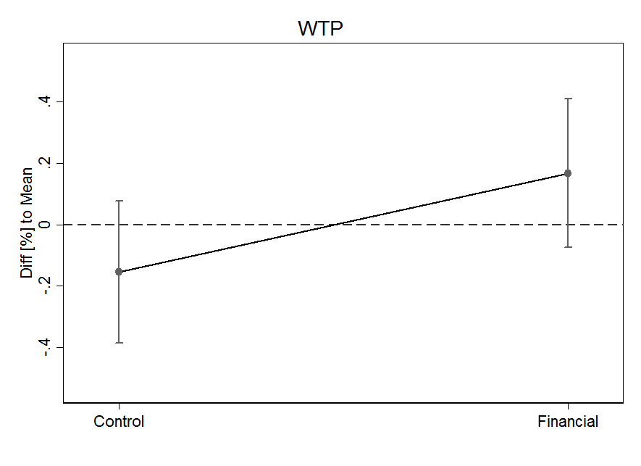
Study 4 Results

Slide 30
Study 5: Financial Literacy Training and Negative Emotions
Read a control reading from the California DMV or a piece from MyMoney.gov
Shame scale
Positive and Negative Affect Scale (PANAS)

Slide 31
Study 5 Results
Negative Emotions
Shame

Slide 32
Study 5 Results
Low Financial Stress
High Financial Stress

Slide 33
But, there is some good news!

Slide 34
Just-In-Time Education
One hour of instruction immediately = 12 hours of instruction after 10 months
Some evidence that effects may be larger for interventions immediately before behaviors
Also some suggestion of increased effectiveness at decision points
  E.g. budgeting right before a new semester

Slide 35
Other Factors
Financial literacy is much less predictive when you include other factors
Propensity to plan
Confidence in financial information search
Willingness to take investment risks
Economic Locus of Control

Slide 36
Economic Locus of Control
Internal – belief that one can shape one’s economic outcomes
External – belief that external forces are responsible for an individual’s financial situation
Growing up with insecurity (economic, psychological, etc.) leads to external locus of control

Slide 37
Economic Locus of Control
Individuals with an internal locus of control are:
More likely to save money
Accumulate more savings overall
More likely to plan when under economic threat

Slide 38
Going Forward
Traditional financial education is not effective at changing behaviors.
However, that doesn’t mean these behaviors cannot be changed!
Teaching financial skills indirectly (e.g. locus of control, propensity to plan)
Providing the right training at the right time
There are other ways to provide financial education
Humor
Sharing experiences
Community support groups

Slide 39
Thank you!

