Slide 1
Leading in the 21st Century
Nick Prewett, University of Missouri
Winter Conference 2017

Slide 2
Leading Through Challenges
Legislation and Regulation
Effective Communication
Technology
Enrollment Management
Adaptation
Winter Conference 2017

Slide 3
Legislation & Regulation (and “politics”)
Winter Conference 2017

Slide 4
Legislative Action Impacts Everyone
Winter Conference 2017

Slide 5
“Politics”
What are the prevailing views?
Selection criteria
Who?
How much?
Who are you representing?
Are you taking a position?
What does the institution gain from that position?
What do students gain from that position?
Is higher education a public good or a private good?
Winter Conference 2017

Slide 6
Accountability
Stewardship of scarce financial aid resources
Pell Grants
Loan subsidization
Merit based aid
Need based aid
Determining:
Who?
How much?
Selection criteria
Winter Conference 2017

Slide 7
Accountability: Pell
Pell Grant
Partisan issue in Washington
Federal budget hasn’t been set in years, CR’s determine funding levels
Higher Education Act Reauthorization, IF/When waiting game.
Expectation that colleges and universities will need to provide additional funding
Regulation updates
Shrinking eligibility pool
Maximum limitations on eligibility
Enrollment limitations on eligibility
Winter Conference 2017
Notes:
0 Estimated Family Contribution (EFC) to records, making undergraduate students eligible for the maximum Pell grant, was changed from $31,000 in 2011-2012 to $23,000 for 2012-2013.
No Long term stability plans

Slide 8
Leading: Through the Community
State and local government interaction
State committee representation
Active dialogue with legislators
Visibility at the capitol
Strong relationship with system campuses
Media outreach
Newspaper
Television
Winter Conference 2017

Slide 9
Regulatory Issues
We are all stewards of federal, state and institutional funds.
Higher Education Act
Prior Prior Year – Early awards?
Perkins
One Grant – One Loan
48 Disclosure Requirements
Winter Conference 2017

Slide 10
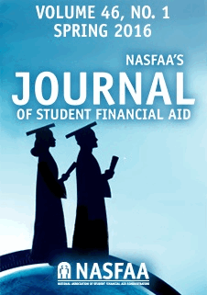
Utilize the Tools Available to You

Slide 11
Effective Communication & Advocacy
Winter Conference 2017

Slide 12
Notes:
One way to communicate is to advocate for what you do as an FAA….

Slide 13
WFAAD: Students & Families
Administer financial aid programs
aid availability, qualifications, distribution, etc.
Application processing
help students file FAFSAs, verify eligibility, etc.
Financial literacy and debt management strategies
Mitigate students’ special circumstances
Advocacy
Winter Conference 2017

Slide 14
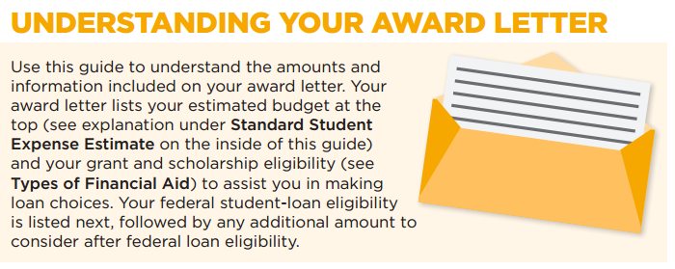
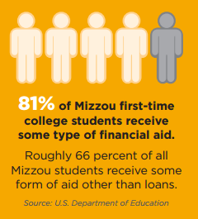
Consider Your Audience
Winter Conference 2017

Slide 15
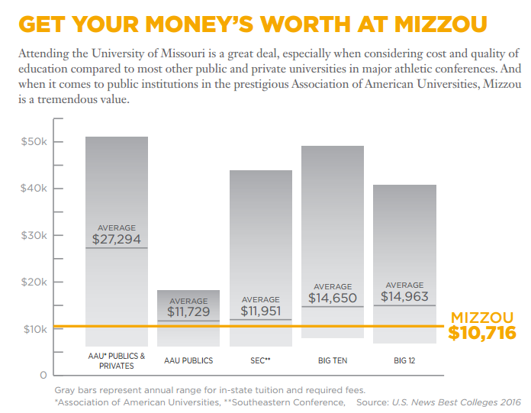
Winter Conference 2017

Slide 16
WFAAD: The Institution
Enroll & retain students
manage processing and disbursement of funds to help students meet institutional costs
provide student employment opportunities
Protect the institution
ensure compliance with laws and regulations
Membership and participation in professional development provide opportunities for advocacy and professional development
Advocacy
Winter Conference 2017

Slide 17
Consider Your Audience
SAP presentations to campus colleagues
Sample financial aid packages
Foundation/alumni support
Increasing understanding of costs & options
Annual report
The art of saying no
Winter Conference 2017

Slide 18
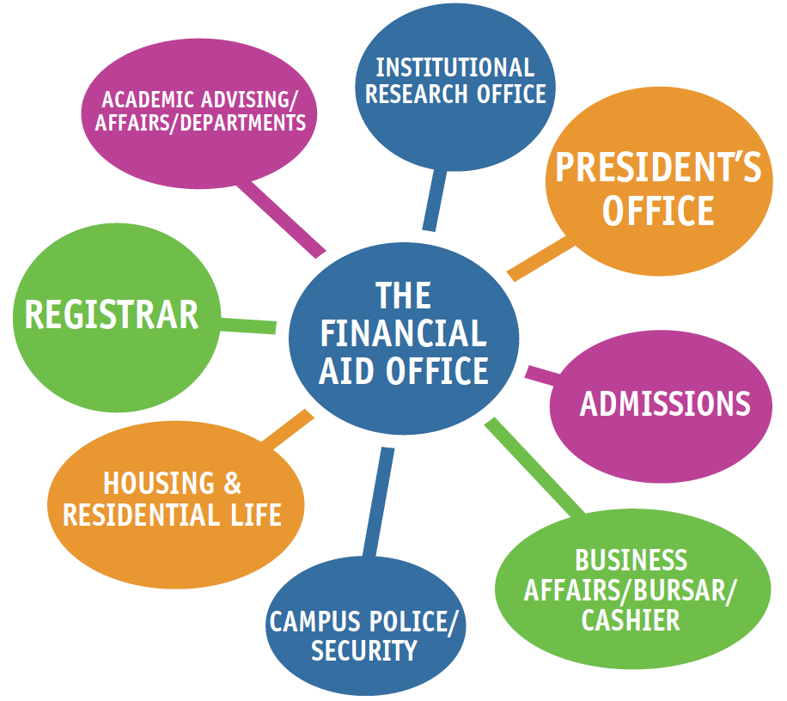
Winter Conference 2017

Slide 19
WFAAD: The Community
Provide student employees
community service activities
math and/or literacy tutors
local business and economic development
Serve as a resource for
high school counselors
community-based college access programs
Educate the community, justify state funds
State and local policies, statutes, regulations
Advocacy
Winter Conference 2017

Slide 20
For You & Your Office (and FA pros)
Descriptive statistics
aid applications and recipients
funding increases and decreases
Office contacts by phone and in-person
Justify institutional budget requests
Visibility as part of recruitment
Training and professional development
Leadership, vision, goals, strategy
Experiences of your staff & leveraging knowledge
Winter Conference 2017

Slide 21
Communication Strategies
Don’t speak ill of people or openly complain
Be personable/likeable and be authentic
Focus on your added value
Have an open mind and listen
Know what you’re talking about and read between the lines
Investigate, research, draft, edit, then respond
Winter Conference 2017

Slide 22
Technology
“The human spirit must prevail over technology.” – Albert Einstein
Winter Conference 2017

Slide 23
Technology changes, do we?
Financial aid management systems drive our life and our yearly schedule
Transactional systems versus analytical systems
Automated communications
Social media approach
Winter Conference 2017
Notes:
Nick

Slide 24
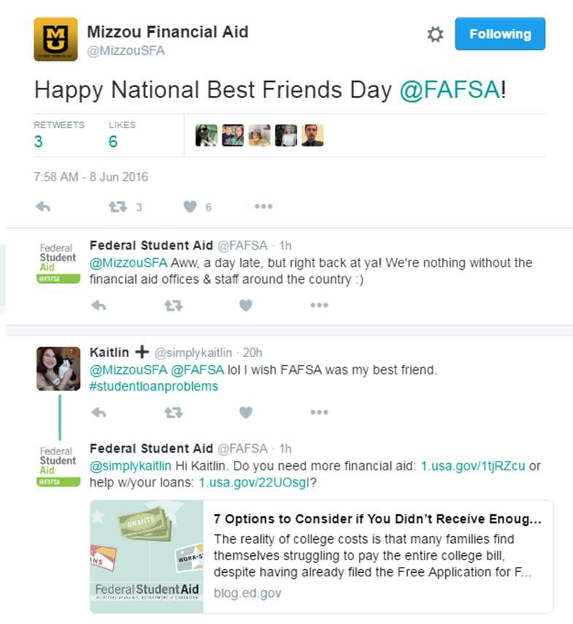
Connect where students are
Notes:
Nick, We used a student worker to run our Twitter account. She has passion and drive to do it, so we let her go with it.

Slide 25
Know Your Data
Buzz words: predictive analytics, discount rates, big data
At-a-glance sheet for yourself, dashboards with up-to-date information
Observe the data, find patterns
Increase in low-income students? Alert support services of potential increased demand
Winter Conference 2017
Notes:
Justin

Slide 26
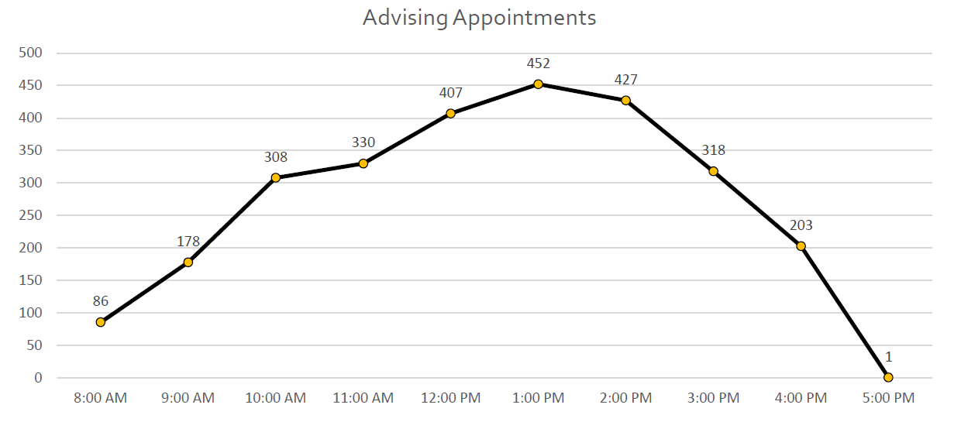
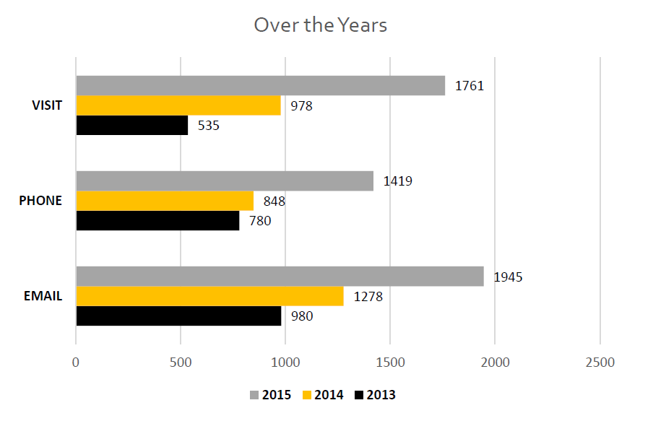
Tracking Student Contact
Winter Conference 2017
Notes:
Nick’s slide

Slide 27
Verification Data
Highlights
AY 2016 | AY 2017
90% of students chosen for verification were in the V1 group | 91% of students chosen for verification were in the V1 group
31% of verification occurred in February | 29% of verification occurred in February
99.62% of students’ EFC was below $100,000 | 99.58% of students’ EFC was below $100,000
50% of students’ EFC was between $1,001 and $5,000 | 45% of students’ EFC was between $1,001 and $5,000
29% of students’ EFC was below $100 | 34% of students’ EFC was below $100
 | V4 saw a spike in verification in August

Slide 28
Enrollment Management & Data Analytics
How to tell people what you do
Winter Conference 2017

Slide 29
Impact of Enrollment Management
Affordability, cost structure, and pricing more important now than in the past in the college choice process
Financial aid playing larger role in recruitment and retention
Strategies/focus differentiated by sector
Consider how much financial aid impacts individuals throughout the entire cycle
Winter Conference 2017

Slide 30
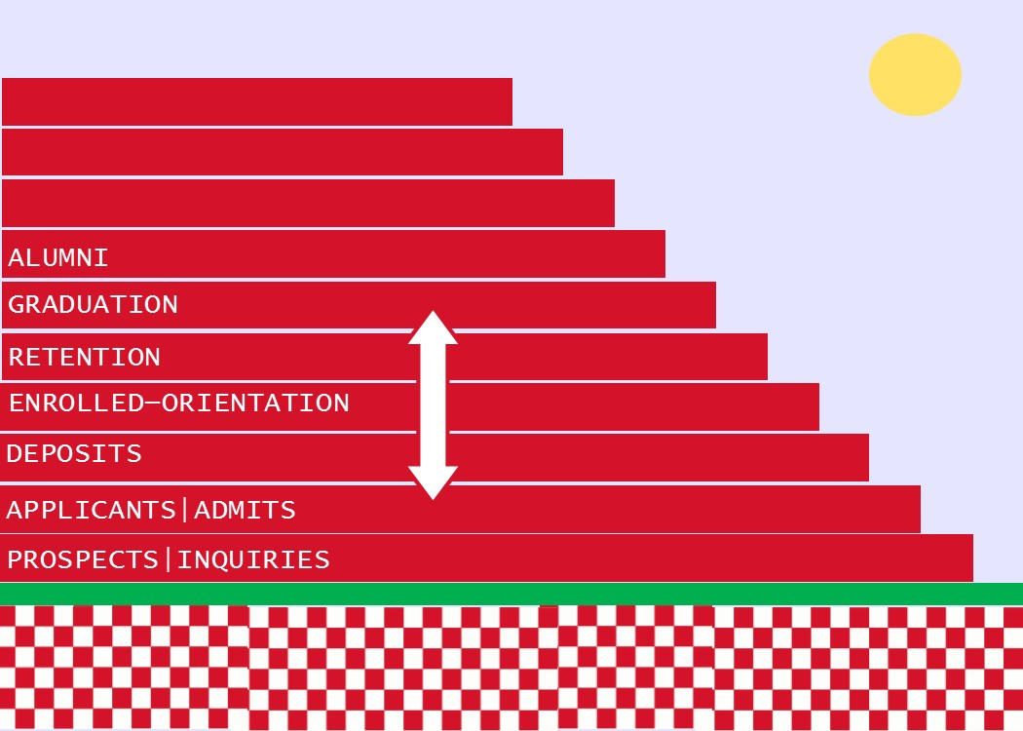
Enrollment Management “Funnel”

Slide 31
Strategic Enrollment Management Role?
Student retention initiatives
High impact practices
Targeted publications, phone calling campaigns
Intentional and coordinated advising
Collaboration with academic advising community
Aggressively promoting support services
Campus activities, social media engagement
Streamlining processes and removing barriers
Instructional videos? Online forms?
Winter Conference 2017

Slide 32
Fundamentals of Enrollment Management
Where is your institutional mindset?
How does your school shape its marketing and recruitment? Stay on that message.
How do you/Admissions engage Colleges and Departments? Alumni? Consistent messaging.
What role does Financial Aid have in the Merit vs. Need-based aid discussion?
Be at the table to influence the process.
Winter Conference 2017

Slide 33
What Are You Looking For?
Find the data support your goals and objectives and how to plan to accomplish those
Increased academic profile, revenue, diversity, retention, student experience, residents?
What is most important and fits mission?
Know the profile of those succeeding
How might you replicate that in others?
Identify barriers and work to eliminate them
Campus-wide collaboration and buy-in
Winter Conference 2017

Slide 34
More Info
Winter Conference 2017

Slide 35
Adaptation
Winter Conference 2017

Slide 36
Planning & Implementing Change
Leadership support
Data analysis and staff involvement
Communication
Implementation rollout
Follow up and assessment
Addressing barriers
Celebrate accomplishments
Winter Conference 2017

Slide 37
Planning & Implementing Change
Human capital is your greatest asset
People over processes first
Relationships, trust, and leadership
The heart of the organization, leads to effective decision-making
Structures and formal processes
Radical alteration ineffective and inefficient without trust and relationship-building
Winter Conference 2017

Slide 38
Peripheral Vision
Maintain a balanced operation with intense focus, but ensure you’re assessing new threats or opportunities on the periphery at all times
Notice and interpret correctly, identify weak and ambiguous signals = early warning signs of impending change; make it your own
What are the current, prevailing views?
Entertain multiple hypotheses, adapt throughout
Winter Conference 2017

Slide 39
Questions?
prewettn@Missouri.edu
Winter Conference 2017

