Slide 1
Millennials and Beyond
Speakers: Donette Cassman
Date: January 26, 2017

Slide 2
Defining the Generations

Slide 3
Who’s Who Over the Years
Baby Boomer (1945-1964) | Gen X (1964-1980) | Millennial or Gen Y (1980-2000) | Gen Z or iGen (2000-Present)
Face-to-Face or Call | Phone, E-mail or IM | Just Text Me | @me (Instagram, Snapchat, Twitter)
Live to work | Work to Live | Play then Work | Work? What’s work?
Touch-tone phones | Give them the latest technology | I’ll Google it myself, connected | Apps vs. Internet
Respect My Title “Me Generation” | Respect My Ideas Independent | Respect & Challenge them, Helicopter Parents Prefers Teams | Creative Helicopter parents
Relationship focused at work | Output focused | Focus on involvement and Digital Natives – Wi-Fi | Digital Natives – 5 Screens – Touch Screen
Work Comes First (Career, Title, Money) | Family comes first | Friends comes first | TBD – still coming of age
Source: Information gathered on 8/5/16 from http://opi.mt.gov/pub/rti/EssentialComponents/Leadership/Present/Understanding%20Generational%20Differences.pdf and
http://www.wmfc.org/uploads/GenerationalDifferencesChart.pdf
Notes:
Millennials and Gen Z are the most avid users of technology.
Please note the start and end dates of each generation are within a year or so of each other as there are many definitions of the begin and end dates for each generation. So the begin and end dates are blended.

Slide 4
Millennial Impact
Born after 1980: Roughly 77 million people, 24% of US population
Age of adults in 2016: 20 to 35
America’s largest and most diverse population
15% were born in a foreign country
In 2012: 15.8 million students making up 75% of Higher Ed. Enrollment are millennials
Also known as Generation Y, millennials make up about one-fourth of the US population (Nielsen)
As the Baby Boomers generation taught us, the larger the generation the greater the influence over norms, expectations and behavior
By 2018, Millennials will have the most spending power of any generation as they will eclipse Boomers
Sources: Information gathered 8/2016 from Pew Research Center survey conducted Feb. 14-23, 2014 among 1,821 adults nationwide, including 617 Millennial adults, and analysis of other Pew Research Center surveys conducted between 1990 and 2014 http://www.pewsocialtrends.org/2014/03/07/millennials-in-adulthood/ , Ryan-Jenkins http://www.ryan-jenkins.com/2013/09/16/22-shocking-stats-about-millennials-to-help-you-chart-tomorrows-change/ , and Nielsen http://www.nielsen.com/us/en/insights/reports/2014/millennials-breaking-the-myths.html

Slide 5
Millennial Generation: Basic Facts
Diverse
Pressured to Perform
Ambitious/Achievers
Team Oriented
Connected
Service Oriented
Excellent Time Managers
Structured
Protected
Source: Alicia Moore, Director of Admissions/Registrar; Central Oregon CC, “They’ve Never Taken A Swim and Thought About Jaws: Understanding the Millennial Generation”

Slide 6
Millennials vs Baby Boomers
Millennials are a generation of Debit Card Users; More than half prefer using a “Card”
Baby Boomers -77% would prefer to use cash
According to a survey administered by FICO, Millennials are 10X more likely to use peer-to-peer lending compared to the Boomers generation
In 2014, according to Experian, Millennials held the lowest amount of overall debt and bankcard debt on average, compared to the other generations
Millennials had average debt of 23k compared to Gen Xers with average debt of 30k
The average Millennial credit score is 625, and 28 percent of them are ranked below 579, says NerdWallet
In the world of credit scores, anything above 660 (out of 850) is considered good.
Based on Millennial credit habits, those scores may not improve
Less than half of Millennials have a credit card
While Millennials have the lowest overall debt and bankcard debt… Millennials have the highest credit utilization rates, though credit limits should increase
Sources: Information gathered 8/2016 from http://www.phillyvoice.com/what-is-wrong-with-millennial-credit-scores/ and FICO Survey http://www.fico.com/en/01-27-2015-fico-survey-american-millennials-will-step-up-use-of-non-traditional-banking-services-this-year and Experian: http://www.experian.com/live-credit-smart/state-of-credit-2013.html?WT.srch=PR_CIS_StateofCredit2013_11192013_4thannual

Slide 7
Millennials in the Marketplace

Slide 8
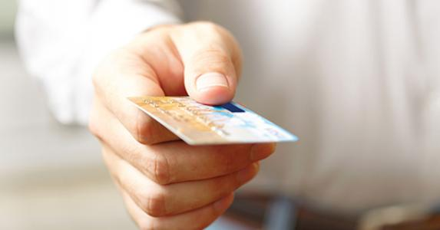
Spending Behavior of Millennials
By 2018, Millennials will have the most spending power of any generation
Almost 50% of Millennial grocery shoppers say they want to be the very first to try new technology
Millennials are much more likely to be influenced by smartphone applications (262% more likely), mobile advertising (+294%), and recommendations from social media sites compared to the average shopper (+247%)
They want to engage with brands on social networks so brands that serve a Millennial’s need may keep them for life
Source: Information gathered 8/2016 from http://resources.bazaarvoice.com/rs/bazaarvoice/images/MillennialsInTheAisles.201208.pdf

Slide 9
What are the top 7 things Millennials buy more than anyone else? Can you guess?
Hot Sauce
Organic Food
Bulk Warehouse Foods
Craft Brews
Same Day Delivery
Newspapers & Magazines
Diet Soda
Gas Station Food
Tattoos & Piercings
Postage Stamps
Mass Market Beer
Energy Drinks
Source: Information gathered 8/2016 from http://time.com/money/3979425/millennials-consumers-boomers-gen-x/

Slide 10
What are the top 7 things Millennials buy more than anyone else? Can you guess?
Hot Sauce
Organic Food
Bulk Warehouse Foods
Craft Brews
Same Day Delivery
Newspapers & Magazines
Diet Soda
Gas Station Food
Tattoos & Piercings
Postage Stamps
Mass Market Beer
Energy Drinks
Source: Information gathered 8/2016 from http://time.com/money/3979425/millennials-consumers-boomers-gen-x/

Slide 11
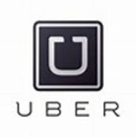
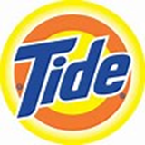
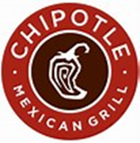
Marketing Trends
Forbes released a study about Millennial consumer tendencies and compiled a list of trends that have enough momentum to be cornerstones of marketing to Millennilsa
Millennials:
- want to engage with a brand on social network
- want to help companies develop future products
- strive for a healthier lifestyle
- value authenticity more than content
- utilize multiple tech devices (87% use between 2-3 devices at least once daily)
- expect companies to give back to society
Some of the most well known brands are already adapting to these trends, but so are the newest brands to the market place
Source: Information gathered 8/2016 from http://www.forbes.com/sites/danschawbel/2015/01/20/10-new-findings-about-the-millennial-consumer/2/#1ff6fd6342b8 Forbes article 2015 and Mindy Weinstein; founder and president of Market MindShift: https://www.searchenginejournal.com/trillion-dollar-demographic-10-brands-got-millennial-marketing-right/135969/
Notes:
On the next few slides we will highlight the trends in marketing for Millennials

Slide 12
Marketing Trends Continued (Forbes)
Trend #1- Tech Immersion
Wearable tech is the new trend that did not stick with millennials right away, but as the price point becomes more “Millennial friendly,” we will see young adults sporting more tech innovations on their wrists
Wearable tech will truly take off in the healthy living space where brands like Jawbone Up and Fitbit have already experienced the highest rates of success
Trend #2- Mobile Payment Will Become the Norm
Millennials are the most on-the-go generation to date and are constantly seeking out ways to streamline their busy lives
Venmo, Apple Pay and Snapcash make it easy for them to transfer money while shopping and to one another
The platforms are designed to make the payment process even more efficient and remove the fees that many associate with mobile or online payment options
According to data released by Forrester, mobile payments will reach close to $90 billion by 2017
Source: information gathered 8/2016 from Forbes Jeff Fromm “Five Millennial Trends That Will Pave The Way for Marketers in 2015

Slide 13
Marketing Trends Continued (Forbes)
Trend#3 – Value Experiences
Rather have a great experience than buy an expensive pair of shoes
Trend #4 – Re-imagination of Social Marketing
Facebook has dominated Social Marketing since its origination, but other brands have begun finding ways to engage younger demographics
Three in ten Facebookers say they have “un-liked” a brand within the last 30 days, while 38 percent of 16-24 year olds have done the same
This ratio is worse than Twitter and even Google+
The faster brands are able to respond in real-time to consumers, the faster they will convert them into loyal brand partners
Trend #5 – Fast Casual
Chains traditionally labeled fast food are now creating in-store atmospheres that are more fast casual
Brands that create this higher quality (fast) food with a sit down and enjoy atmosphere will set themselves apart (Chipotle)
Source: Information gathered 8/2016 Forbes Jeff Fromm “Five Millennial Trends That Will Pave The Way for Marketers in 2015
Notes:
Just a quick note on Trend #3
While the Millennial will rather spend money on an experience and more importantly on one that no one else had while the Gen Z person would rather spend money on something to own like a house or car or other stuff.
Gen Z would rather own than the Millennial that chooses to rent or lease.

Slide 14
How to Engage the Generation
Millennials indicated a trend towards the easier to use, more transparent, data-driven, and automated processes of online lending when compared to tradition banks
In 2014 pluralthinking released a cultural intelligence report. According the report:
Gen Z has the lowest attention span to date. They won’t wait for a web page to load, 32% will start abandoning slow sites between one and five seconds, after 8 seconds they’ll consider it broken.
Brands need to learn the fine balance between narrowing down choice and content to maintain attention spans and deliver speed while still catering for variety
Gen Z doesn’t differentiate between online and offline. The physical and virtual are the same thing
Gen Z’s whole lives are interconnected with what they do, how they do it and why they do it
Millennials check their phones as many as 43 times daily and more than 30 percent stated they are more loyal to brands that are up-to-date in regards to technology
Nearly half of social media users get their investment and savings information from their Facebook friends
Reviews from family and friends are more trusted than traditional media
Source: Information gathered on 7/23/16 from 2014 Plural Thinking Study, Forbes Generation Z:Rebels with a Cause, and Investopedia.com/articles/investing/022715/how-millennials-use-tech-social-media-invest.asp, and www.adweek.com/socialtimes/nearly-half-of-social-media-users-trust-facebook-friends-for-financial-advice-inforgraphic/633624

Slide 15
How to Reach Millennials on your College Campus

Slide 16
Success with The Millennial Generation on Campus
Admissions and Marketing:
Support from parent(s)/family about decision around higher education. Colleges are recruiting families too.
Photos and Videos of campus must appeal to parents. Families need to protect in new environment. Safety on campus is important.
Decisions around Higher Ed are made based on parent’s perspective and what peers are doing. Recruitment of one well known student causes a ripple effect on others from same high school.
Millennials are team and traditional-oriented. Videos and photos must appeal to these traits engaged in campus wide activities not of a student sitting along studying in a library.
Stay in front of prospective students as much as you can. If you aren’t they will go elsewhere.
Be tech-savvy and don’t fake it!
Source: Alicia Moore, Director of Admissions/Registrar; Central Oregon CC, “They’ve Never Taken A Swim and Thought About Jaws: Understanding the Millennial Generation”

Slide 17
Success with The Millennial Generation on Campus, cont.
Service Oriented Generation: Do you have an active AmeriCorps Program?
Generation that has largest amount of discretionary time - Fill it!
Traditional hallway-styled residence halls out the window??
Not interested in the traditional food service program. “Grab & Go” generation; 24/7 service
Burnout for this generation is strong. Expand personal counseling services on campus
Move as many services as you can on-line!
Remember to provide services for parents; stay connected to them!
Source: Alicia Moore, Director of Admissions/Registrar; Central Oregon CC, “They’ve Never Taken A Swim and Thought About Jaws: Understanding the Millennial Generation”

Slide 18
Banking and financial trends

Slide 19
Banking and Financial Trends
EverFi and Higher One have conducted extensive research into the financial attitudes, knowledge and behaviors of college students. For their 2016 study, they surveyed approximately 85,000 students from four-year institutions and 4,300 from two-year institutions across the United States.
Millennial students’ attitudes about money “displayed more materialism, more compulsion, less caution and less aversion to debt as time spent on campus increased”
They are less likely to pay their credit card bill on time, follow a budget, or save money
Millennials are taking out more and larger student loans, yet report feeling less financially prepared to deal with them
Two-year college students are smarter about money than those in four-year universities
Source: Information gathered 8/2016 from 2016 Everfi, Higher One White Paper “Money Matters on Campus” http://moneymattersoncampus.org/wp-content/uploads/2016/04/EverFi_WhitePaper_2016_FINAL-Web.pdf

Slide 20
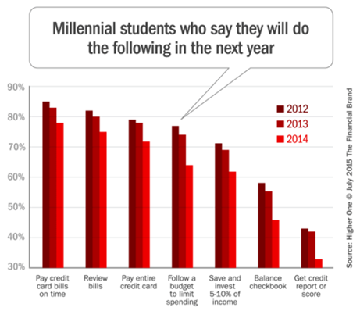
Millennial Financial Behavior
Source: Information gathered 8/2016 from 2015 Everfi, Higher One White Paper “Money Matters on Campus” http://moneymattersoncampus.org/wp-content/uploads/2016/04/EverFi_WhitePaper_2016_FINAL-Web.pdf

Slide 21
Comparing Four-year and Two-year institutions
Four-Year Institutions
Two-Year Institutions
Only 45% of students say they feel prepared to manage their money
70% don’t use budgets
Experience increase in college preparedness after the first year, not so for 2-year students
17% agree that their parents manage their finances as compared to 11% for two-year students
Financial literacy should teach them the basics of budgeting and saving as well as introducing them to more complex issues such as investing and planning for the future
60% of students said they check their account balances (compared to 50% of 4-year students)
40% of two-year students say they use budgets (compared to 30% of 4-year students)
41% of students are 21 years or older while 51% of 4-year students were 18 years old
Displayed healthier financial attitudes and were more cautious, more adverse to debt, more utilitarian, and less materialistic
Experience more financial stress, on average, and have fewer resources
Could also use additional support in regards to credit card behaviors as they tend to have more cards and outstanding debt and are likely to pay late
Source: information gathered 8/2016 from 2016 Everfi, Higher One White Paper “Money Matters on Campus” http://moneymattersoncampus.org/wp-content/uploads/2016/04/EverFi_WhitePaper_2016_FINAL-Web.pdf
Notes:
Across the span of semester, students from both institution type reported significant decreases in reported financial monitoring behaviors.
Low rates of using money managing tools across both institution types

Slide 22
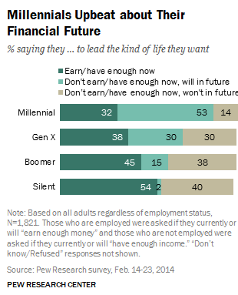
Millennials Financial Future
Source: Information gathered 8/2016 from http://www.pewsocialtrends.org/2014/03/07/millennials-in-adulthood/

Slide 23
Here comes Gen Z?

Slide 24
Generation Z
Born 2000-today
Post 9/11 reality: early loss of innocence
Most tech savvy generation; touchscreens
Prefers incognito and anonymous social networks (Whisper, Snapchat, and Secret as opposed to Facebook)
8-second attention spans
PSA - Phone Separation Anxiety
Politically liberal, social equality biggest concern
Source: Information gathered 8/2016 from Gettinggenz.com “Getting to Know Generation Z”
http://growingleaders.com/blog/generation-z-differs-generation-y/
Notes:
This subset is still emerging. The start date most articles reference is 2000 however, some researchers say Gen Z is as early as those born in 1996.
While GenY/Millennials initiate text messages as a norm, Gen Z/iGen utilize images, icons, and more symbols
While Gen Y/Millennials prefer to spend money on experiences, GenZ/iGen prefers t traditional ownership and wants to own both houses and cars.

Slide 25
Generation Z
Trends in Education:
Less reliance on physical classroom
Realistic vs. optimistic
Debt avoiders, less impulsive
Want training vs. general education
Source: Information gathered 8/2016 from forbes.com Generation Z: Rebels With A Cause: http://www.forbes.com/sites/onmarketing/2013/05/28/generation-z-rebels-with-a-cause/#3b18d84a6aa1

Slide 26
Conclusion
Habits and trends vary from generation to generation
We will need to adapt our messages and approaches to be effective
That may mean changing our processes and cycles to be in line with their expectations

Slide 27
Questions?

Slide 28
The information contained in this presentation is not comprehensive,
is subject to constant change, and therefore should serve only as
general, background information for further investigation and study
related to the subject matter and the specific factual circumstances
being considered or evaluated. Nothing in this presentation
constitutes or is designed to constitute legal advice.
08/2016 MKT11982

