Slide 1
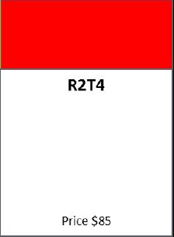
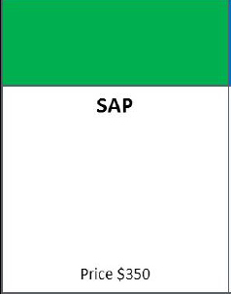


The Shoe and the Thimble:
Things You May Not Know about R2T4 and
Enrollment Status and Reporting
Zack Goodwin
US Department of Education
ISFAA Conference, Indianapolis, IN
January 26, 2017
Enrollment Status and Reporting

Slide 2
Agenda

Slide 4
Audits and Program Reviews
R2T4 issues are frequently among the top audit and program review findings
Miscalculations
Funds returned late

Slide 5
Counting Days
Su
M
T
W
Th
F
S
Su
M
Is there a scheduled break for R2T4 purposes?
(Green indicates days where classes are held)

Slide 6
Counting Days
Su
M
T
W
Th
F
S
Su
M
Is there a scheduled break for R2T4 purposes?
(Classes are held only on weekends)

Slide 7
Counting Days
Su
M
T
W
Th
F
S
Is there a scheduled break for R2T4 purposes?

Slide 8
Counting Days
Su
M
T
W
Th
F
S
Su
M
What is the student’s withdrawal date?

Slide 9
Modules
5 days
Module 1:
50 days
Module 2:
50 days
Module 3:
50 days
25 days
50 days
25 days

Slide 10
Modules
4 days
Module 1:
50 days
Module 2:
50 days
Module 3:
50 days
25 days
35 days

Slide 11
Modules
In most cases, when a student in a program offered in modules drops future courses on the last day of a module, the student is considered a withdrawal and the days including the dropped courses are included in the R2T4 calculation.
If that last day of attendance reflects completing a module, then the student is not considered a withdrawal.

Slide 12
Rounding
Dollars
  Round to the nearest penny
  When returning funds, may round to the nearest dollar
Percentages
  Calculate to the fourth digit
  Round to the third
33.77% → 33.8%

Slide 13
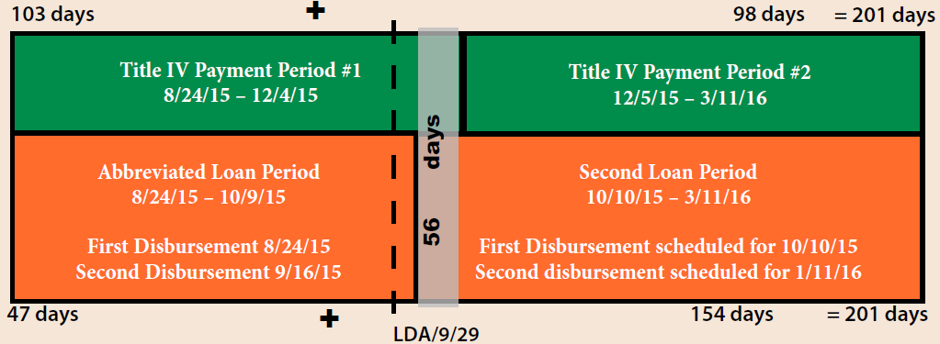

Rounding
36.36% → 36%

Slide 14
Timeline
The R2T4 calculation must be performed within
30 days of the date of determination
Funds must be returned within 45 days of the date
of determination

Slide 15
MPN and Entrance Counseling
If a student signs the MPN prior to the
R2T4 calculation being performed,
loan funds may be included as
aid that could have been disbursed

Slide 16
Resources
FSA Handbook: Volume 5
Program Integrity Q&A: R2T4 in Modules

Slide 17
Enrollment Status and Reporting

Slide 18
Degree Requirements
“If a student is enrolled in courses that do not count toward his degree, certificate, or other recognized credential, they cannot be used to determine enrollment status unless they are eligible remedial courses. This means you cannot award the student aid for classes that do not count toward his degree, certificate, or other recognized credential.”
Federal Student Aid Handbook, page 1-18

Slide 19
Majors and Minors
There is flexibility for schools to decide what counts toward each individual student’s degree, certificate, or other recognized credential. This allows for the provision of Title IV aid for multiple majors and for academic minors and concentrations.

Slide 20
Prerequisites
If a student is taking a course that must be taken
in order to qualify to enroll in a course that is required for the program of study, the student
may receive Title IV aid for the prerequisite course under the remedial coursework provisions.

Slide 21
Graduate Students
For graduate programs, full-time enrollment status may be defined differently in summer than during the academic year. Half-time status must still reflect at least half of the full-time status definition.

Slide 22
Audits and Program Reviews
NSLDS enrollment reporting issues are frequently among the top audit and program review findings
Reporting inaccuracies
Untimely reporting

Slide 23
Program Length
Credential Level | Credential Level Description | Minimum Years > or = | Maximum Years < or =
01 | Undergraduate Certificate or Diploma Program | 0.1 | 10
02 | Associate's Degree | 0.4 | 10
03 | Bachelor's Degree | 0.9 | 10
04 | Post Baccalaureate Certificate | 0.4 | 10
05 | Master's Degree | 0.4 | 12
06 | Doctoral Degree | 0.9 | 12
07 | First Professional Degree | 0.2 | 10
08 | Graduate/Professional Certificate | 0.2 | 10
99 | Non-Credential Program [Preparatory Coursework/ Teacher Certification] | 0.1 | 10

Slide 24
Program Length
020000
Y
30

Slide 25
Enrollment Update Page
Users may filter search results to exclude students with certified programs
Results may be sorted by oldest certification date first
  Results may also be sorted by certification date on the
  Enrollment Maintenance page
    Warning icon will appear if student has not been certified in more than 65 days

Slide 26
Program Enrollment Detail
Student-level enrollment reporting history is listed for all programs attended
  Each record indicates a new enrollment status
  May view reporting history program-by-program
NSLDS professional website
Enroll tab
Enrollment Summary

Slide 27
Enrollment Submittal Tracking
Enrollment roster submittal history may be obtained for all school locations
  Reflects rosters sent by NSLDS, submittals to NSLDS, and updates made via the NSLDS Professional website
  If the school uses a servicer for enrollment reporting, the total count of records listed may include other schools’ records
NSLDS professional website
Enroll tab
Enrollment Reporting Profile

Slide 28
Enrollment Submittal Tracking
NSLDS Enrollment Submittal File Tracking Report (SCHET1)
  Provides data from Enrollment Submittal Tracking page in Microsoft Excel format
NSLDS professional website
Report tab
Web Report List

Slide 29
Roster Reset
Users may push back onto a school location’s
current roster all students who had appeared on
previous enrollment roster(s) since a specific date
NSLDS professional website
Enroll tab
Enrollment Reporting Profile

Slide 30
Late Enrollment Certifications
Schools may request a list of students who have not had an enrollment certification reported after a specified date
(SCHLC1)
  The CSV version may be imported into a spreadsheet, and later submitted to NSLDS via the Enrollment Spreadsheet Submittal process
NSLDS professional website
Report tab
Web Report List

Slide 31
Enrollment Errors
Schools may request reporting error/acknowledgement information for a given school code, within a specified timeframe (SCHER5)
  Data available only from the report’s implementation date forward,
  November 20, 2016
NSLDS professional website
Report tab
Web Report List

Slide 32
10%

Slide 33
Graduation Reporting
If a student’s graduation status is effective after the last day of classes, students may be reported as withdrawn until graduated status is reported, in order to prevent loss of Direct Loan subsidy
Electronic Announcement: September 25, 2015

Slide 34
Resources
NSLDS Enrollment Reporting Guide (November 2016)
NSLDS Newsletters #53, #55 and #56
Electronic Announcement: May 13, 2016

Slide 35
Thank you!
Zack Goodwin
zachary.goodwin@ed.gov
617.289.0051

Slide 36
ED Contacts: Chicago
Institutional Improvement Specialists
Effie Barnett
effie.barnett@ed.gov
312.730.1587
George West
george.west@ed.gov
312.730.1538

Slide 37
ED Contacts
Research and Customer Care Center
800.433.7327
fsa.customer.support@ed.gov
Reach FSA
855.FSA.4FAA -- 1 number to reach 10 contact centers!
Campus Based Call Center eZ-Audit
COD School Eligibility Service Group
CPS/SAIG Foreign Schools Participation Division
NSLDS Research and Customer Care Center
G5 Nelnet Total & Permanent Disability Team

Slide 38
We Appreciate Your Feedback
To ensure quality training we ask all participants to please fill out an online session evaluation:
https://www.surveymonkey.com/s/ZacharyGoodwin
This evaluation tool provides a means to inform us of areas for improvement, and to support an effective process for listening to our customers.
Additional feedback about training can be directed to joann.borel@ed.gov.

Slide 39


