Slide 1
Unconscious Bias in the Workplace
Toni Neely

Slide 2
PRESENTATION OBJECTIVE
To define diversity, inclusion and other key terms to help increase both the awareness and understanding of the business case for incorporating a diversity initiative into your strategic training plan
Diversity & Inclusion is a business imperative
Notes:
2

Slide 3
DIVERSITY
The acknowledge-ment of ALL human differences

Slide 4
INCLUSION
Proactive behaviors that make others feel valued and respected

Slide 5
THE LEVEL PLAYING FIELD INSTITUTE VOLUNTARY TURNOVER BASED SOLELY ON PERCEPTIONS OF UNFAIR TREATMENT COST U.S. BUSINESSES AN ESTIMATED $64B A YEAR

Slide 6
KEY TERMS
AFFIRMATIVE ACTION | CONCEPT TO INCREASE REPRESENTATION
DIVERSITY | NOUN WHICH DESCRIBES DEMOGRAPHICS
INCLUSION | VERB WHICH SPEAKS TO PROACTIVE BEHAVIORS
CULTURAL COMPETENCIES | SKILLS REQUIRED TO CREATE INCLUSION & LEVERAGE DIFFERENCES
ENGAGEMENT | INCREASED PRODUCTIVITY AND $$$$

Slide 7
AFFIRMATIVE ACTION
What year enacted
Who was President
Explanation
1965
Lyndon Johnson
Federal Contract Equal Representation

Slide 8
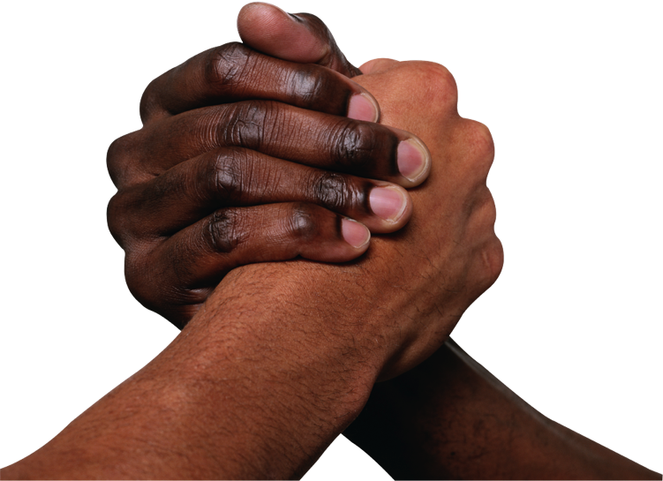
SOCIAL DISTANCE
Definition: Social distance is the degree to which people are willing to accept and associate with those having different social characteristics. For example, an unwillingness to live next door to a family of a different race would indicate a high degree of social distance. On the other hand, willingness to marry a person of a different race would indicate a very low degree of social distance.

Slide 9
Quality of Work Relationship Decreases
Barriers to Productivity Increase
Informal Development
Task Effectiveness
Resource Utilization

Slide 10
IF YOU DON'T INTENTIONALLY INCLUDE, YOU WILL UNINTENTIONALLY EXCLUDE
Notes:
10

Slide 11
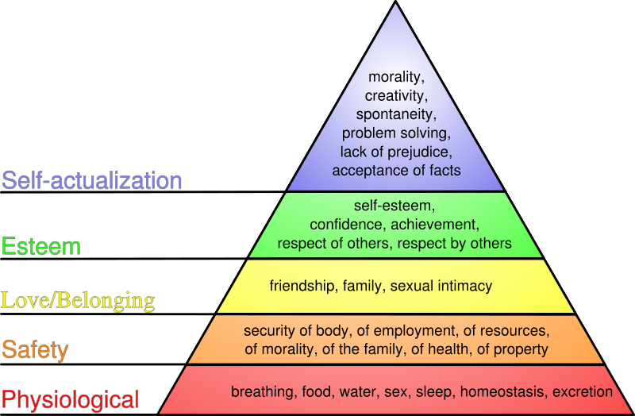
Maslow’s Hierarchy of Needs

Slide 12
SARATOGA INSTITUTE 80% OF TURNOVER IS DIRECTLY RELATED TO AN UNSATISFACTORY RELATIONSHIP WITH ONES BOSS
THE COST OF UNINTENTIONAL TURNOVER
.5 TO 1.5 THE ANNUAL SALARY
10 POSITIONS AT 100K EACH =
$500,000 - $1,500,000

Slide 13
U.S. DEMOGRAPHIC TRENDS
Hispanics are now the largest minority group; population over 38M
Minority purchasing power is projected to increase from $1.3T in 2000 to $6.1T by 2045
LGBT buying power for 2012 was $790B

Slide 14
U.S. DEMOGRAPHIC TRENDS
Asian Americans make more money than any other ethnic group
Women = 51.2% of U.S. population, influence 80% of purchasing decisions and spend close to $13.5 trillion per year

Slide 15
DIMENSIONS OF DIVERSITY

Slide 16
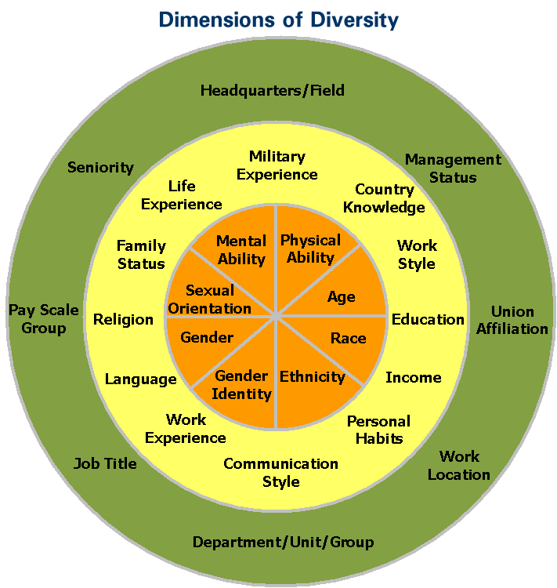

Slide 17
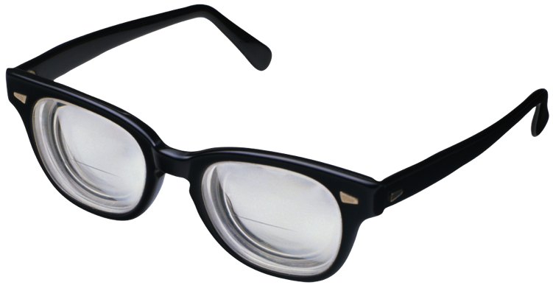
Intent vs. Impact
I don’t see color…
I don’t see you as a woman…
Your sexual preference…
S/he must be a terrorist…

Slide 18
PERCEPTION IS…
EASY!!!!

Slide 19
ASK THE DIVERSITY QUESTION
"What is it that you might be experiencing that is preventing you from making your maximum contribution?”
If you don’t ask, you assume…and making assumptions is not the most solid business platform on which to stand.
Notes:
19

Slide 20
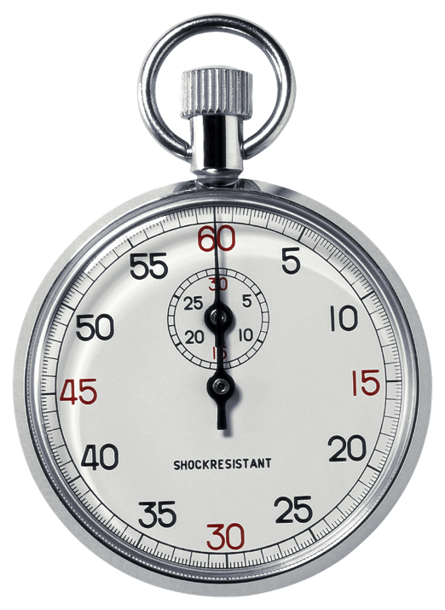
ASK THE DIVERSITY QUESTION
But…I don’t have time…
If you don’t ask, inconvenience will turn into conflict...and conflict with turn into crisis…
Crisis will turn into $$$
Notes:
20

Slide 21
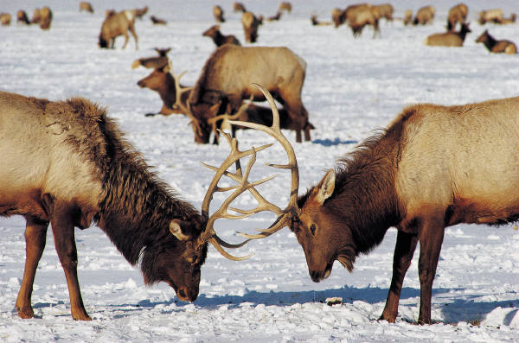
What you ignore becomes more…
What you tolerate will soon take over…
But what you challenge, will change…
In other words…what you permit…you promote
Notes:
21

Slide 22
DENISON CONSULTING & GALLUP
Contented employees provide 3X’s more revenue growth
Improving employee satisfaction 15% increased financial performance 40%
When culture and strategy align, companies have 4X the revenue growth and 12X stock value
Notes:
22

Slide 23
LEVERAGE DIFFERENCES
Increase revenue
Increase productivity
Attract and retain the best and brightest
Competitive advantage
Decrease turnover rate
Collaboration, Cooperation, Teamwork
Extraordinary results
Notes:
23

Slide 24
Thank You
Toni Neely

