Slide 1
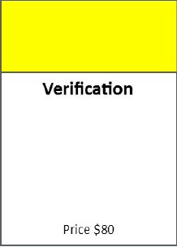
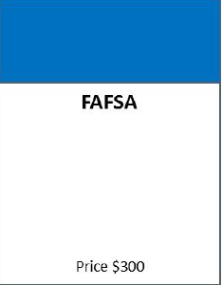


Do Not (Yet) Pass Go:
Verification and
Conflicting Information
Zack Goodwin
US Department of Education
ISFAA Conference, Indianapolis, IN
January 26, 2017
1

Slide 2
Agenda
General verification reminders and updates
2016-2017 verification
2017-2018 verification
Conflicting information and comment code 399

Slide 4
Progress!
 | 2015-2016 | 2016-2017 | 2017-2018
V1 | X | X | X
V2 | reported only | reported only
V3 | X | reported only
V4 | X | X | X
V5 | X | X | X
V6 | X | X

Slide 5
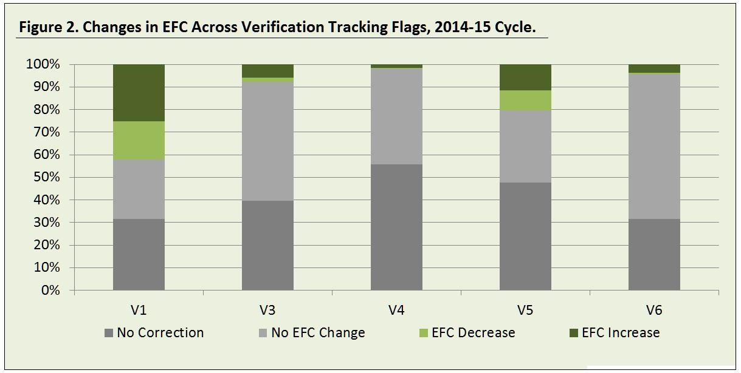
Verification and EFC Changes
For Tracking Group V1
42% had corrections that led to a change in EFC

Slide 6
V4/V5 Tracking Results
The V4 and V5 tracking process in
FAA Access that was required as of 2014-2015 remains in effect for
2016-2017 and 2017-2018
https://faaaccess.ed.gov

Slide 7
V4/V5 Tracking Results
Whom to report: Students for whom school received an ISIR with a verification Tracking Group of V4 or V5 AND for whom school requested verification documentation
  Do not include students the school selected
  Do include students eligible only for unsubsidized aid
When to report: 60 days following the institution's first
request to the student for the required documentation
  Changes to previously submitted verification results must be updated within 30 days

Slide 8
V4/V5 Tracking Results
Dropdown options are:
  Verification completed in person, no issues found
  Verification completed remotely, no issues found
  Verification attempted, issues found with identity
  Verification attempted, issues found with high school completion
  No response from applicant or unable to locate
  If issues are found with BOTH identity and
  high school completion, school should indicate issues found with identity (#3)

Slide 9
V4/V5 Tracking Results: 2017-2018
Dropdown options are:
  Verification completed in person, no issues found
  Verification completed remotely, no issues found
  Verification attempted, issues found with identity
  Verification attempted, issues found with high school completion
  No response from applicant or unable to locate
  Issues with both identity and high school completion

Slide 10
Undocumented Parents/Spouses
An incorrect Social Security Number in itself does not always impede verification or constitute conflicting information
  Tax filing requirements still apply for
  undocumented immigrants
  Identity theft and fraud issues may be raised

Slide 11
2016-2017

Slide 12
2016-2017 Verification Overview
Same data elements as for 2015-2016
Tracking group V3 eliminated
Some modifications and clarifications to acceptable documentation
In limited circumstances, an applicant’s verification Tracking Group could be changed to V5

Slide 13
2016-2017 Tracking Group Changes
Applicants may be moved from previously assigned Groups V1, V4, and V6 to verification Tracking Group V5
Applicant is only required to verify the additional items in V5 that were not previously verified

Slide 14
2016-2017 Tracking Group Changes
If the applicant is moved to Tracking Group V5, no additional disbursements of any Title IV aid may be made until verification is satisfactorily completed
  If Title IV aid had been disbursed prior to receiving an ISIR with the new V5 selection, and the applicant does not complete verification, the applicant is liable for the full amount of Title IV aid disbursed for 2016-2017 even if no longer enrolled
  The institution is only liable for any portions of those disbursements that must be returned by the school as a result of the student’s withdrawal

Slide 15
2016-2017 Tracking Group Changes
In general, whether selected initially or on a subsequent transaction, student must complete verification of the information required for the current verification Tracking Group
Electronic Announcement: October 31, 2016
Applies to 2016-2017 and subsequent award years

Slide 16
2016-2017 Verification
Income Information for Non-IRS Tax Filers
Tax filers who filed an income tax return with a taxing authority in a U.S. territory (Guam, American Samoa, the U.S. Virgin Islands) or commonwealth (Puerto Rico and the Northern Mariana Islands) or with a foreign central government, must submit a copy of a transcript of their tax information
  A signed copy of the applicable 2015 income tax return that was filed with the taxing authority is only acceptable if tax filers are unable to obtain a free copy of a transcript of their tax information

Slide 17
2016-2017 Verification
Income Information for Tax Non-Filers
Residents of the Freely Associated States (Republic of the Marshall Islands, the Republic of Palau, the Federated States of Micronesia), and a U.S. territory or commonwealth or a foreign central government who are not required to file an income tax return under that taxing authority’s rules must submit:
  a copy of their Wage and Tax Statement (or equivalent documentation) for each source of employment income, and
  a signed statement identifying all of the individual’s income and taxes

Slide 18
Not Required to File
      If an institution questions a claim that the tax filer
      is not required to file or otherwise did not file,
      must require applicant to submit an
      IRS Verification of Non-filing Letter
        Does not necessarily resolve conflicting information

Slide 19
IRS Tax Return Transcript Matrix
Electronic Announcement: March 23, 2016
Amended version –
Electronic Announcement: May 4, 2016

Slide 20
2016-2017 Verification
Dear Colleague Letter GEN-15-11
Federal Register: June 26, 2015
Suggested verification text: November 18, 2015
Program Integrity Q & A Website:
Verification topic
Application and Verification Guide
Complete FSA Handbook: December 15, 2016

Slide 21
2016-2017 Documentation Update
Alternative documentation may now be accepted for 2016-2017 when tax filer requested, but is unable to obtain, an IRS Tax Return Transcript using the IRS paper or online request process
  Exception not permitted due to:
    Transcripts being unavailable because the IRS has not had time to process the data, due to recent filing
    The inability to establish an IRS online account
    Electronic Announcement: October 18, 2016

Slide 22
2016-2017 Documentation Update
Alternative documentation includes:
  Signed copy of 2015 IRS tax return, and
  Statement from tax filer, on or attached to the return, certifying data is the same as submitted to the IRS, and
  Communication from IRS stating request unsuccessful
      Letter from IRS (signed and dated by tax filer) or
      Screen shot print (signed and dated by tax filer), and
  Completed and signed IRS Form 4506 T-EZ or 4506-T listing institution as third party recipient
      For mailing only if accuracy is doubted

Slide 23
2017-2018

Slide 24
V1 + V4 = V5

Slide 25
2017-2018 Verification Overview
SNAP benefits, child support paid, and Tracking Group
V6-related untaxed income are no longer required
verification items
Tracking group V6 eliminated
IRS Verification of Non-filing Letter required for all tax
non-filers and for applicants with tax filing extensions
Documentation used to verify certain data elements in
2016-2017 may also be used for 2017-2018 provided it
meets current requirements

Slide 26
Verification of Non-Filing Letter
Required for all students and parents who did not file a 2015 Federal tax return
  Includes those not required to file
  Includes those who requested extensions of time to file
    Schools can opt to re-verify an application once a tax return
    is filed
Currently Form 13873-V is not considered acceptable documentation for verification purposes

Slide 27
Undocumented Parents/Spouses
A parent or spouse who does not have an SSN,
Individual Taxpayer Identification Number (ITIN), or Employer Identification Number (EIN) may submit...
A signed and dated statement:
  Certifying that the individual(s) does not have an SSN, ITIN or EIN
  Listing the sources and amounts of earnings, other income, and resources that supported the individual(s) for the appropriate year
If applicable, a copy of IRS Form W–2 or equivalent document for each source of employment income
Program Integrity Q&A Website (DOC-Q29)

Slide 28
IRS Tax Return Transcript Matrix
Electronic Announcement: January 12, 2017

Slide 29
2017-2018 Verification
Dear Colleague Letter GEN-16-07
Federal Register: April 1,2016
Suggested verification text: July 29, 2016
Program Integrity Q & A Website: Verification topic
Application and Verification Guide:
November 22, 2016

Slide 30
2017-2018 Documentation Update
    Electronic Announcement expected
    winter or spring 2017

Slide 31
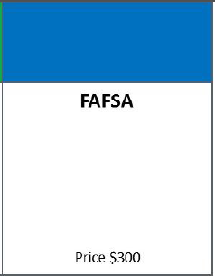
Comment Code 399

Slide 32
What is the best way for
most students to limit the incidence of conflicting information between 2016-2017 and 2017-2018?
Use the IRS Data Retrieval Tool
for both years

Slide 33
Conflicting Information
Increased possibility of conflicting information due to the
inclusion of 2015 income and tax information on the 2016-2017 and 2017-2018 FAFSAs
  Other data, such as household and asset information,
  will be current/projected
ED will identify 2017-2018 applications where conflicting information may exist that, if resolved, would result in a significant change in EFC
Dear Colleague Letter GEN-16-14

Slide 34
Comment Codes 395-399
Comment codes 395-398 indicate possible conflicting information, but resolution is not required
Resolution is required for comment code 399
  If comment code 399 does not appear on the 2017-2018 ISIR, schools are not required to resolve differences in income or tax information between the two ISIRs
  Any other conflicting information must still be resolved

Slide 35
Comment Code 399
If CPS identifies an ISIR as having conflicting information, you will see...
  C Flag
  ISIR comment code 399
  “Your Financial Aid Administrator may contact you to resolve any issues related to differences in the 2015 income information you reported on your 2016-2017 FAFSA and 2017-2018 FAFSA.”

Slide 36
Comment Code 399
most likely
˄
CPS will not flag an ISIR for conflicting information if...
  Student is not expected to be Pell-eligible
  Change in dependency status between the two years
  Change in student’s or parents’ marital status between the two years
  Professional judgment was exercised in either year
  Electronic Announcement: October 13, 2016
  ISIR reprocessing October 17, 2016

Slide 37
Comment Code 399
Comment code 399 does not have to be resolved if...
  School never received a 2016-2017 ISIR
  School received a 2016-2017 ISIR but did not and will not disburse Title IV aid in either year
  Aid was disbursed in 2016-2017, but the student is no longer enrolled and is not expected to return in 2017-2018

Slide 38
Comment Code 399
If a reprocessed ISIR no longer includes Comment Code 399 the institution is not required to take any action
  Any Code 399s on subsequent ISIRs must still be resolved
Code 399 need not be resolved for graduate students if:
  The student is a graduate student in both 2016-2017
  and 2017-2018
  The student did and will not receive Federal Work-Study either year
  Electronic Announcements: October 13 and 21, 2016
  Future ISIR reprocessing?

Slide 39
Comment Code 399
  If the student is no longer enrolled and is not expected to re-enroll for 2016-2017, or enroll
  for 2017-2018, the institution is not required to resolve the possible conflicting information
  Early FAFSA Q&A: G-Q12

Slide 40
Known Issues
most likely
˄
CPS will not flag an ISIR for conflicting information if...
  Student is not expected to be Pell-eligible (Automatic Zero)
  Change in dependency status between the two years
  Change in student’s or parents’ marital status between the two years
  Professional judgment was exercised in either year

Slide 41
Resolving Conflicting Information
School must compare 2015 income and tax-related items from both years’ ISIRs to determine conflict
  Compare ISIRs that were/will be used to award Title IV aid
If in either year the school had verified the income and tax information, or the IRS Data Retrieval Tool was used and no data was changed, school can assume these values are correct and submit changes to the other year...unless the school is aware an amended tax return was filed.

Slide 42
Resolving Conflicting Information
2017-2018 ISIR
  If required correction is for the 2017-2018 year, school must use EFC from corrected ISIR to award and disburse
2016-2017 ISIR
  If required correction is for the 2016-2017 year, school must ensure that all awards and disbursements for
  2016-2017 reflect the corrected ISIR, whether the EFC
  is lower or higher
  Corrections not required after September 9, 2017
Notes:
While monies earned by a student employed under the Federal Work-Study (FWS) Program never need to be repaid, the institution must immediately cease paying the student with FWS funds.
Exception to making corrections for 2016-17 – Schools are not required to submit corrections to a 2016-2017 ISIR if the published deadline date of September 9, 2017, for making such corrections has passed. In such cases, the school should simply document the reason why the correction was not submitted and no further action is required.

Slide 43
Unable to Resolve
Until conflicting information is resolved, no additional Title IV aid may be disbursed in either year
If the conflicting information is unable to be resolved, the school must consider the student in an overaward status for any need-based 2016-2017 aid disbursed
  Earned Federal Work-Study funds need not be returned, but students may not continue to earn FWS wages
Notes:
While monies earned by a student employed under the Federal Work-Study (FWS) Program never need to be repaid, the institution must immediately cease paying the student with FWS funds.
If the result of the resolution of conflicting information is that the student is not eligible for the full amount of 2016-2017 Title IV aid originally awarded, the institution may need to adjust any Title IV aid that had not yet been disbursed. If no such adjustments can be made, or if any adjustments do not fully resolve the issue, there would be a Title IV overpayment in one or more of the programs

Slide 44
Overawards and Overpayments
Title IV grants and Perkins Loans
  Adjust subsequent disbursements
  If not resolved by adjusting subsequent disbursements,
  student must repay portion disbursed for which no longer eligible
  School is not liable
Direct Subsidized Loans
  Will be repaid under terms of the promissory note, but school must record its determination
Notes:
As we have previously noted, we have developed an “Early FAFSA” mailbox as a way for the community to send us any questions on the implementation of “Early FAFSA” for 2017-2018 and the use of prior-prior year information. The “Early FAFSA” mailbox may also be used for questions and comments regarding the information in this Dear Colleague Letter. The email address of the “Early FAFSA” mailbox is EarlyFAFSAFeedback@ed.gov. Although we will not be able to reply to individual messages, we will carefully review all messages received as we develop additional Early FAFSA guidance, including a set of Questions & Answers (Q&As) that we will post to IFAP.

Slide 45
Thank you!
Zack Goodwin
zachary.goodwin@ed.gov
617.289.0051

Slide 46
We Appreciate Your Feedback
To ensure quality training we ask all participants to please fill out an online session evaluation:
https://www.surveymonkey.com/r/ZacharyGoodwin
This evaluation tool provides a means to inform us of areas for improvement, and to support an effective process for listening to our customers.
Additional feedback about training can be directed to JoAnn.Borel@ed.gov.

Slide 47
Department of Education Contacts
Research and Customer Care Center
800.433.7327
fsa.customer.support@ed.gov
Reach FSA
855.FSA.4FAA -- 1 number to reach 10 contact centers!
Campus Based Call Center eZ-Audit
COD School Eligibility Service Group
CPS/SAIG Foreign Schools Participation Division
NSLDS Research and Customer Care Center
G5 Nelnet Total & Permanent
Disability Team

Slide 48


